Slide 1
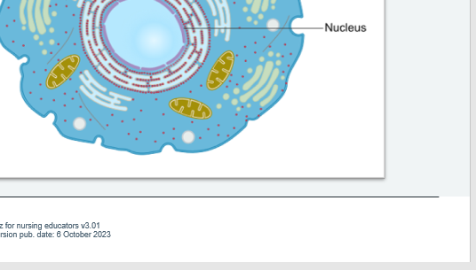
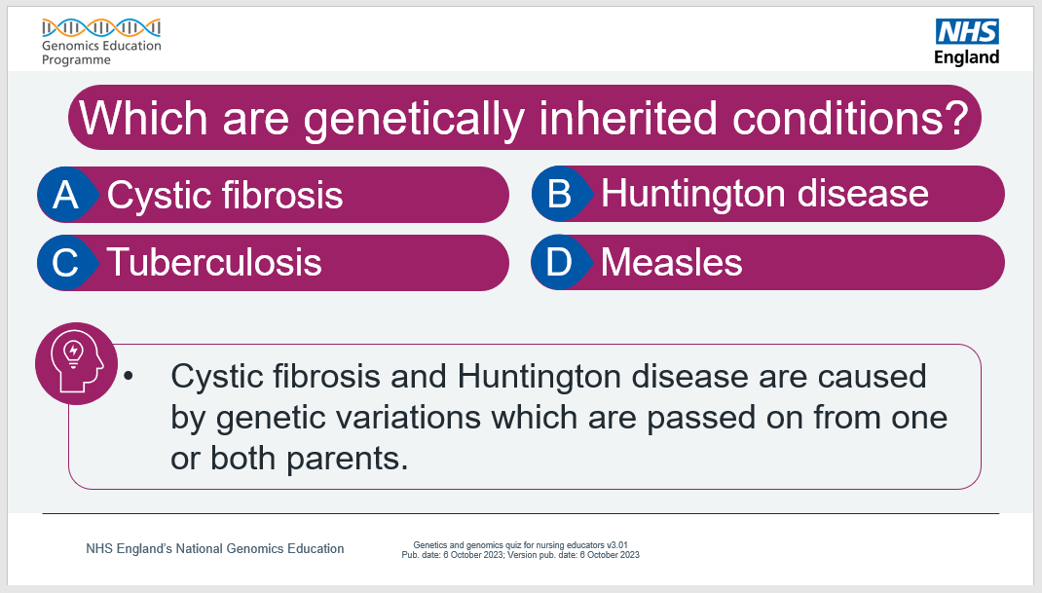
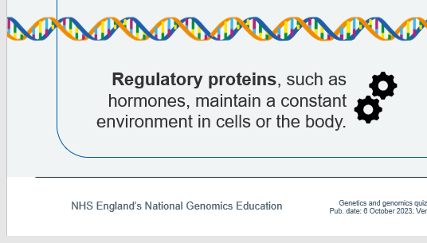
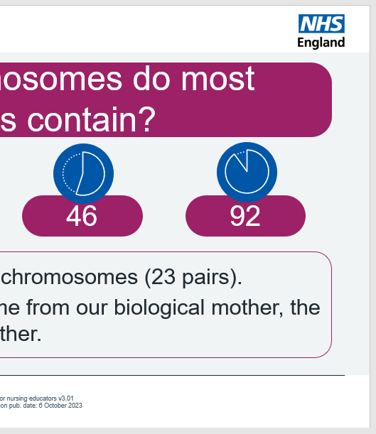
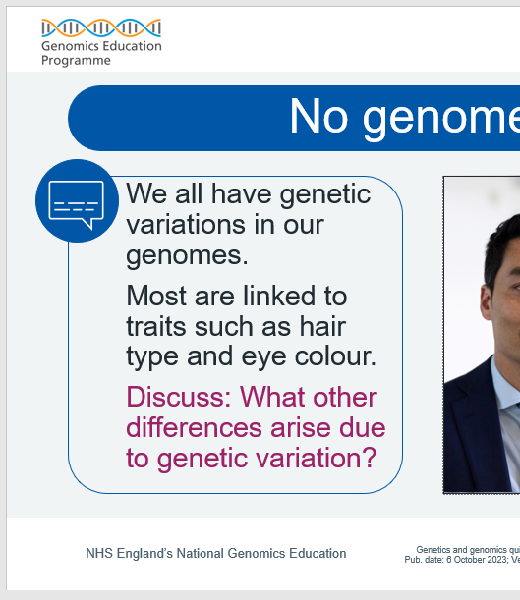
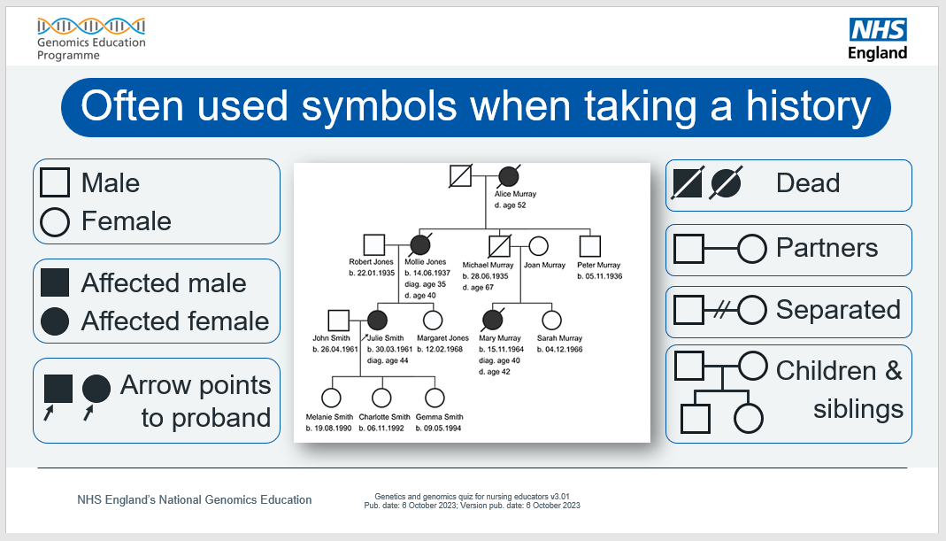
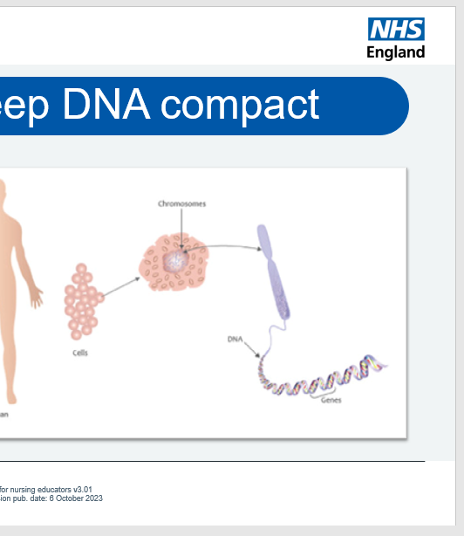
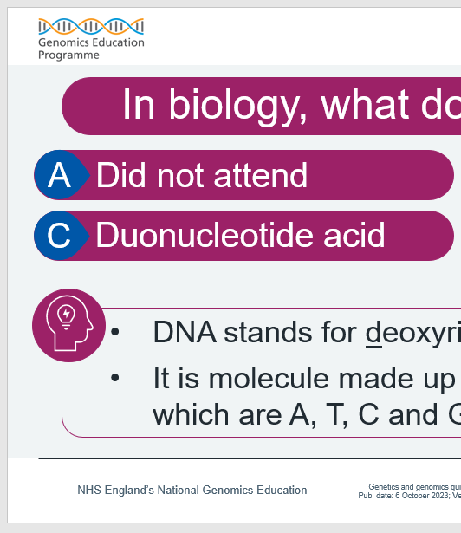
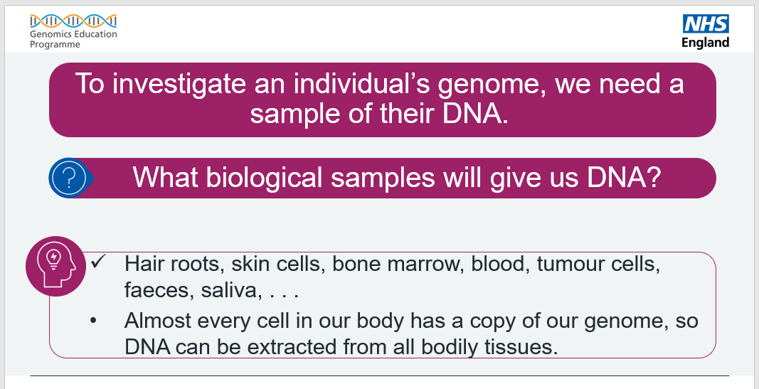
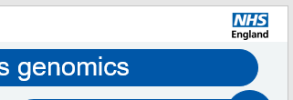
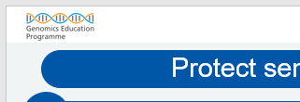
The Genomics Game (quiz)
About
This is an educational quiz to support educators teach genomic concepts, and their applications in healthcare, in a fun and engaging way.
The quiz can be used as a standalone resource or as an adjunct to support and complement other educational activities.
Educators of all healthcare professions may find this quiz useful.

Slide 2
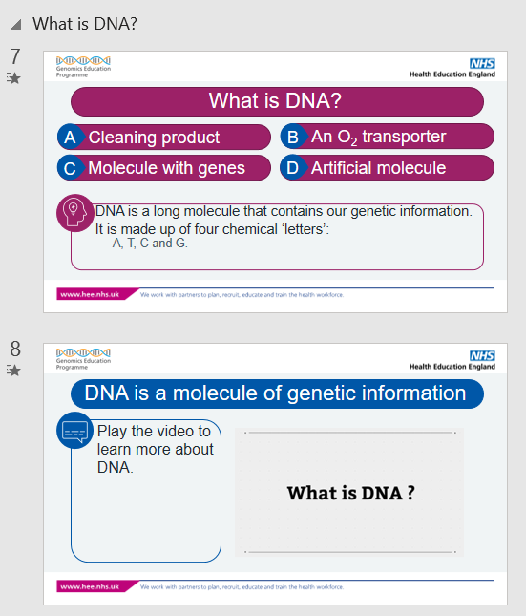
Slides in sections for easy configuration
1) Slide sections.
These keep slide groupings together.
2) Each section has complimentary:
- red-question slides, and
- blue-information slides.

Slide 3
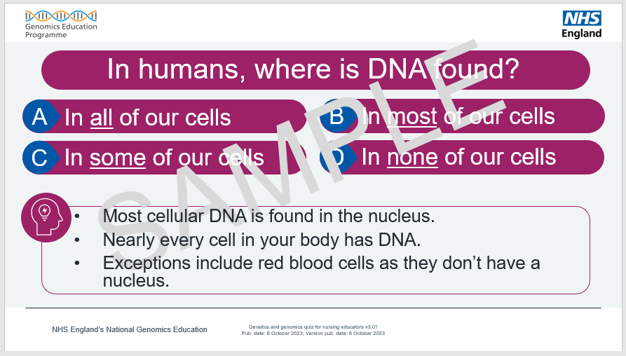

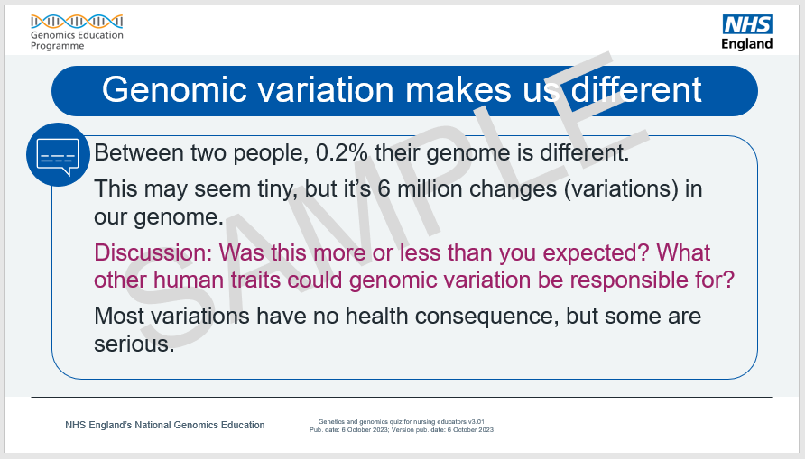
About the slides
The red-question slides – there are over 40 around various genomic themes – also provide information through the box.
The blue-information slides give further information or context to the previous question slides. Some have discussion points.

Slide 4
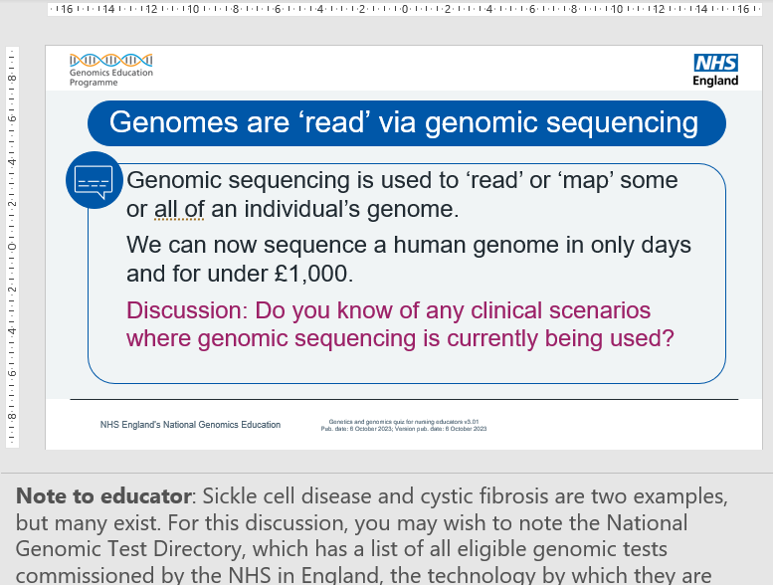
Discussions
Some blue-information slides, like this one, have a structured prompt discussion points (seen in the picture in pink).
Discussions keep learners active during delivery, encourage critical thinking as well as other benefits.
To help you facilitate a group discussion, notes to the educator are provided. These are found both in the slide notes.

Slide 5

How to present these slides
Use the complete slide deck as presented here (we recommend removing this ‘read-me’ section first).
or
Insert individual slides into your own presentation. To do this:
Highlight slides you wish to use.
Copy slides.
Paste, keeping source formatting ( ), into your own PowerPoint file.
For support, see the tutorial video on the next slide or access Microsoft’s help webpage.
For the best experience, present the slides as a slide show ( ) .
For a how-to on presenting as a slide show, please see this Microsoft help webpage.

Slide 6
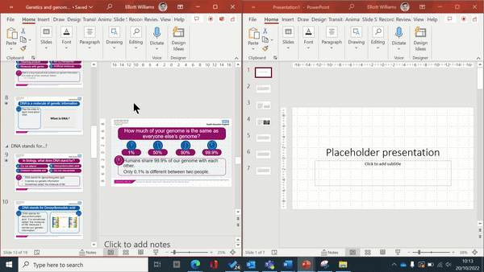
Video: Copy slides into your presentation

Slide 7
The Genomics Game (quiz)
Based on The Genomics Game for in-person learning (found online here),
this quiz resource supports the delivery of genomics education in an online learning environment.
This quiz was made by NHS England’s Genomics Education Programme.

Slide 8
In biology, what does DNA stand for?
Did not attend
Deoxyribonucleic acid
Duonucleotide acid
Dominant nucleic acid
DNA stands for deoxyribonucleic acid.
It is molecule made up of four chemical ‘letters’ which are A, T, C and G.

Slide 9
What does the molecule ‘DNA’ do?
holds our genetic material
transports oxygen to cells
passes on inherited traits
prepares dinner
DNA is a long molecule that contains our genetic information.
Parents can pass on their physical traits because of DNA.
DNA is sometimes called ‘the molecule of life’.

Slide 10
In humans, where is DNA found?
In all of our cells
In most of our cells
In some of our cells
In none of our cells
Most cellular DNA is found in the nucleus.
Nearly every cell in your body has DNA.
Exceptions include red blood cells as they don’t have a nucleus.

Slide 11
Genetics is the study of all an individual’s DNA
True
False
Genetics is the study of individual genes.
The study of all an organism’s DNA is called genomics.

Slide 12
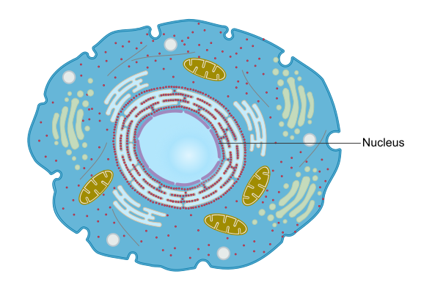
DNA is found in (almost) all cells
DNA is found in a cell’s nucleus.
Almost every cell in your body has DNA.
Exceptions, like red blood cells, don’t have a nucleus so don’t have DNA.

Slide 13
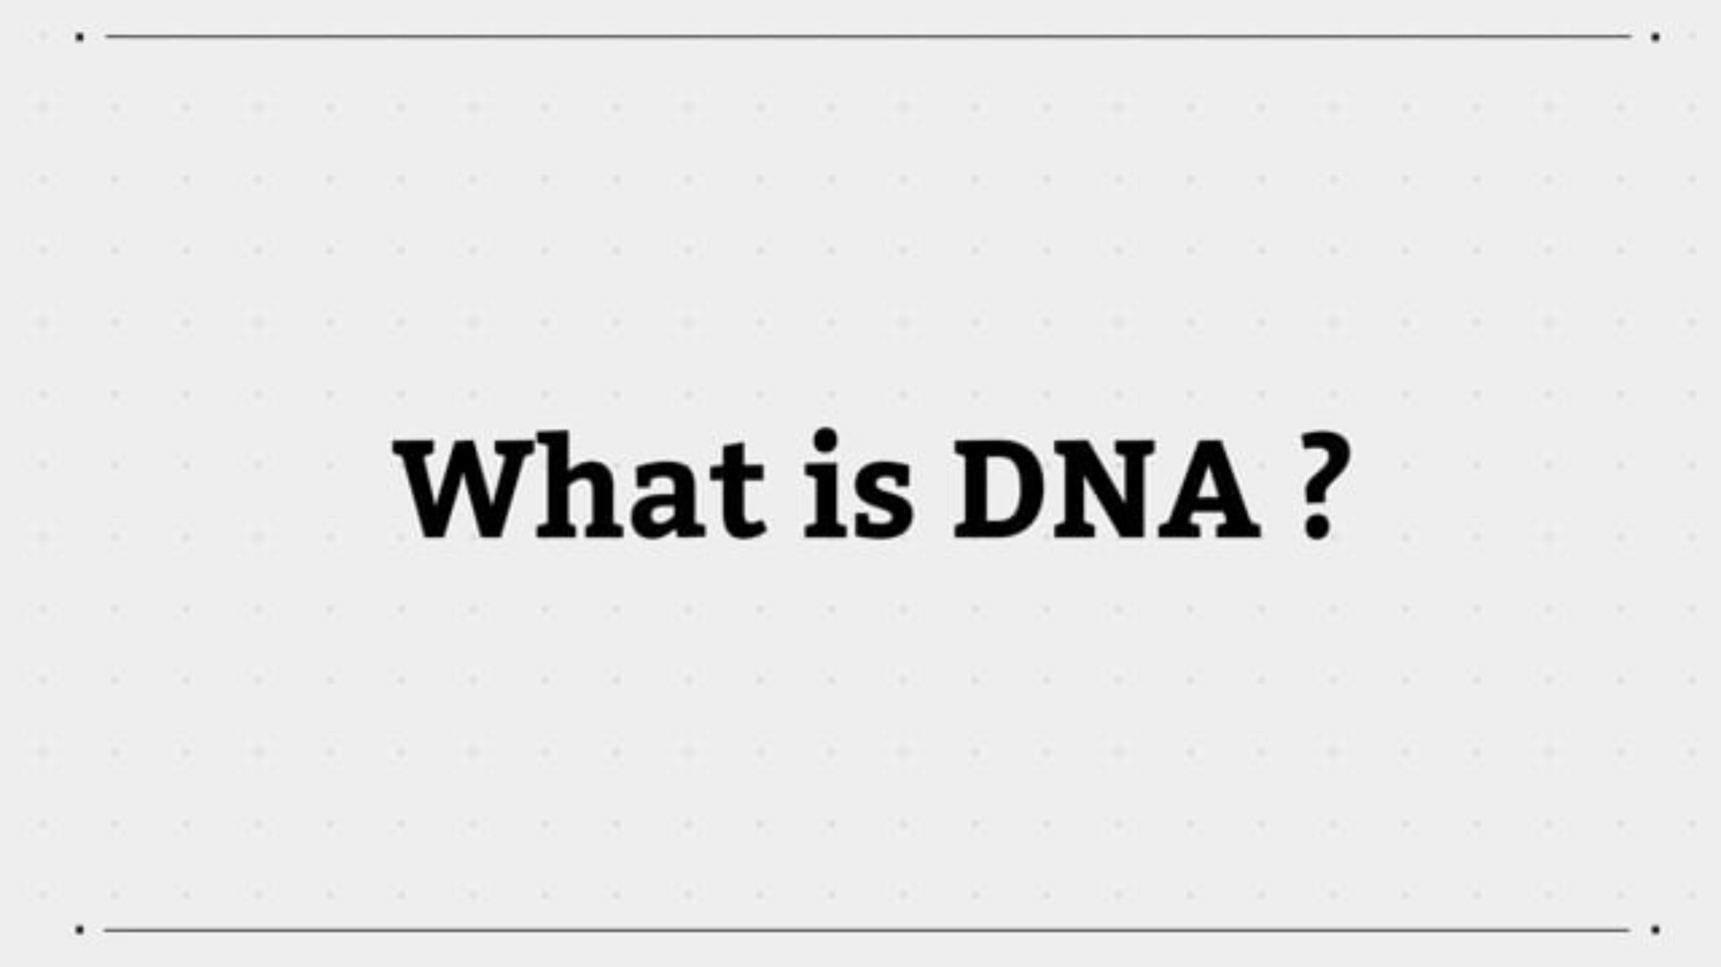

Slide 14
What is a chromosome?
Compact form of DNA
A type of enzyme
An organelle
The centre of the cell
A chromosome is a tightly bundled molecule of DNA and associated proteins.
It is how the DNA is organised in the cell’s nucleus.

Slide 15
How many chromosomes do most human cells contain?
23
24
46
92
Most human cells have 46 chromosomes (23 pairs).
Half our chromosomes come from our biological mother, the other from our biological father.

Slide 16
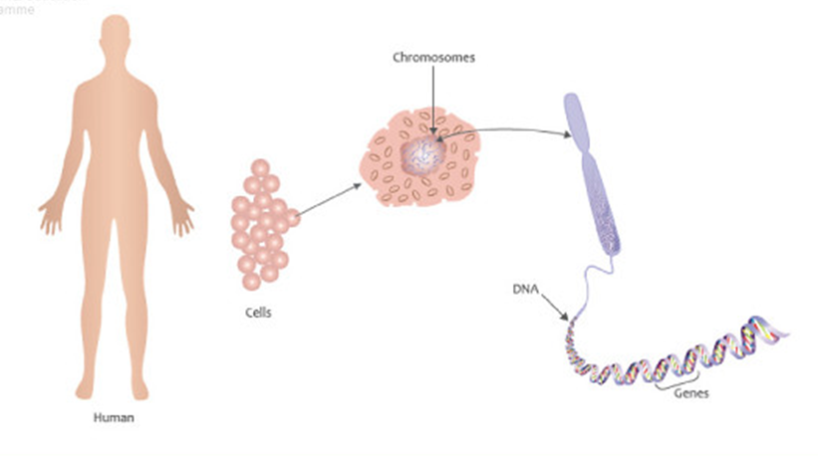
Chromosomes keep DNA compact
A chromosome is a bundled-up long DNA molecule.
It’s how our DNA is organised in the nucleus of our cells.
Unbundled, a cell’s DNA is two metres long.

Slide 17
What are genes?
Specific parts of DNA
All the DNA in the cell
Energy power-houses
A fashion item
Genes are the instructions for making complex molecules, such as proteins.
Genes are needed for our cells to function.

Slide 18
What is a genome (gee-nome)?
A tiny group of genes
A cell’s entire genetic material
A model organism
A garden ornament
A genome is an organism’s complete genetic material.
In humans, this is made of DNA.
The human genome contains 3 billion ‘letters’ of DNA.

Slide 19
How much of your genome is the same as everyone else’s?
1%
50%
90%
99.8%
Among us, 99.8% of our genome is shared.
Between two people, only 0.2% is different.
Most of these differences cause no health problems but some can lead to genetic diseases or conditions.

Slide 20
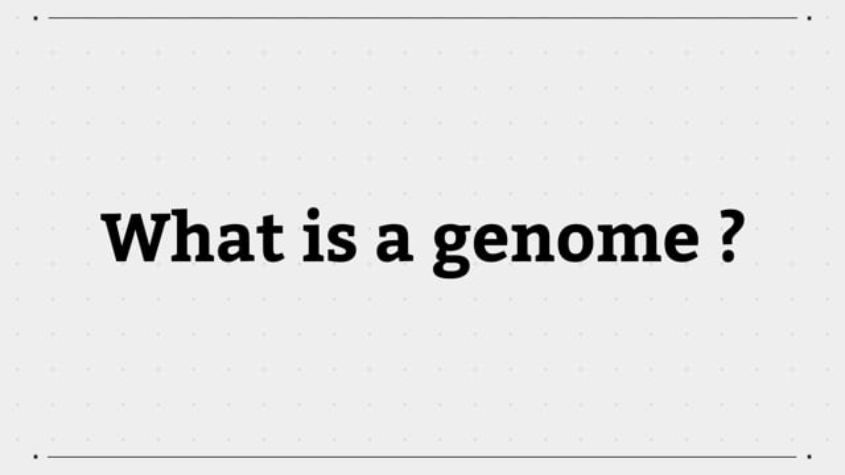

Slide 21
Genomic variation makes us different
Between two people, 0.2% their genome is different.
This may seem tiny, but it’s 6 million changes (variations) in our genome.
Discussion: Was this more or less than you expected? What other human traits could genomic variation be responsible for?
Most variations have no health consequence, but some are serious.
Notes:
Note to educator: For this discussion, get the learners to think about everyday natural human differences like eye colour, hair colour and curl, how individuals perceive the taste of Brussels sprouts or coriander, and so on.
It is also useful to help learners recognise just how similar we are.
Furthermore, stating some fun facts can embed the idea of how important genomic differences in growth and development can help. For example, our genomes are around 98%–99% similar to that of chimpanzees. Also, more than half of our genome shares similarity with less human-like organisms, such as chickens, fruit flies and bananas.
More information:
- Food, glorious food and its bitter aftertaste: www.genomicseducation.hee.nhs.uk/blog/food-glorious-food-and-its-bitter-after-taste/
- Bonobos join chimps as closest human relatives: www.science.org/content/article/bonobos-join-chimps-closest-human-relatives
- Infographic showing “all living things” percentage DNA similarity with humans: www.popsci.com/humans-genetically-linked-to-bananas/

Slide 22
What does the ‘central dogma’ of biology explain?
Protein transport in a cell
How proteins code for genes
How genes code for proteins
Why dogs are cute
A cell ‘reads’ a gene to accurately make proteins, but proteins can’t be read to accurately make genes.
The central dogma describes this one-way flow of information.

Slide 23
Approximately how many protein-coding genes does the human genome have?
2,000
20,000
200,000
2 million
The human genome has about 20,000 protein-coding genes.
These genes tell our cells how to make different types of proteins needed for our cells, organs and bodies to work.

Slide 24
How much of your genome contains the instructions to make proteins?
2%
32%
82%
99%
Less than 2% of your genome tells the cell how to make proteins.
The other 98% is also important, and our knowledge on its role is increasing.

Slide 25


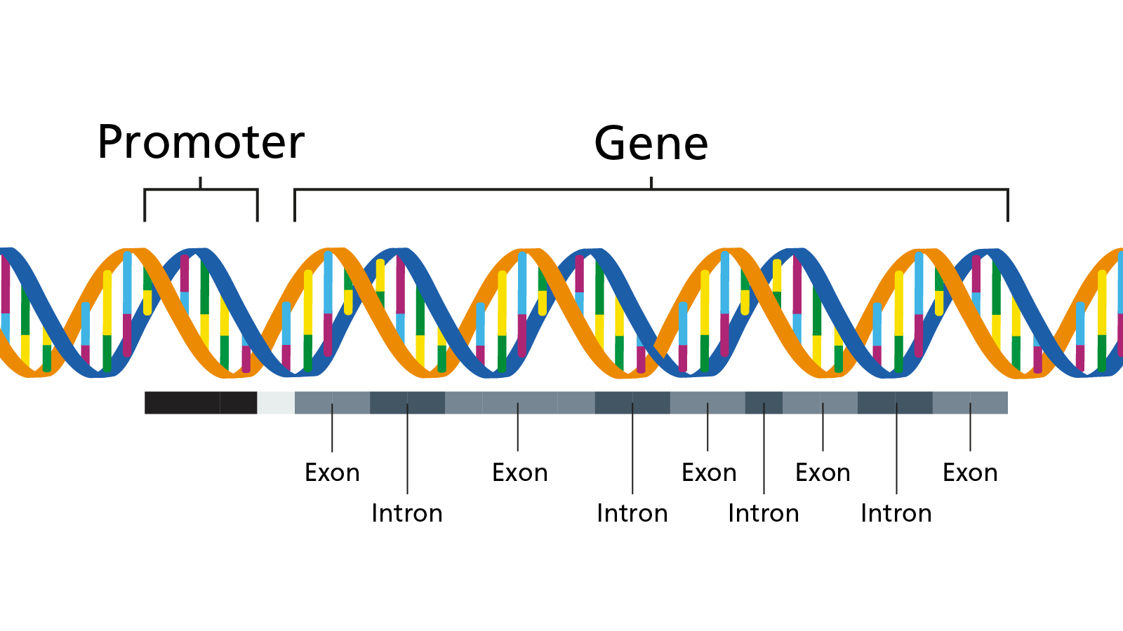


Different types of proteins
Enzymes catalyse, cause or speed up biochemical reactions.
Structural proteins give shape, structure or strength to cells or tissues.
Regulatory proteins, such as hormones, maintain a constant environment in cells or the body.
Defensive proteins work as a part of the immune system keeping us safe.
And many more!
Notes:
Note to educator: Here are some other types of protein and their function:
- Blood-clotting proteins: part of an organism’s blood clotting response.
- Cell membrane/channel proteins: found in a cell’s membrane.
- DNA- and RNA-associated proteins (nucleoproteins): proteins that attach to nucleotides.
- Contractile proteins: help muscle fibres to contract.
- Motor proteins: ‘molecular machines’ that help move material in a cell.
- Receptor proteins: are bound to by other molecules.
- Toxins: used in predation or defence by some non-human organisms.
- Transport proteins: move material in an organism.
- Storage proteins: store something until needed.

Slide 26
Genetics vs genomics
Genetics is often looking at just the roughly 2% of DNA which make proteins.
Genomics is the study of both the 2% and the other 98% – once called ‘junk DNA’ but now we know this isn’t the case.

Slide 27
Which word describes passing down genetic information?
Inherited
Trait
Identity
Transmission
Inherited is the term used to describe a physical characteristic or condition that is shared between biologically related individuals.

Slide 28
In medicine, what word is preferably used to indicate that a gene is different than expected?
Variant
Deformity
Anomaly
Mutation
‘Gene variant’ is the preferred term.
‘Mutation’ is commonly used in research, and occasionally when talking about cancer.

Slide 29
Words have meaning
Healthcare workers are continually understanding how to choose words that sensitively describe a patient’s condition.
Patients with a rare disease report preferring their DNA to be described as having a ‘variant’ causing the condition.
Patients with cancer are neutral to the cancer’s DNA being described as ‘mutated’.
Discussion: Why do you think this is? Are there any other commonly used medical terms that may be distressing for a patient to hear?
Notes:
Note to educator: For this discussion, encourage learners to think about how the patient might feel or react to being referred to as “having a mutation”. Explore how complicated or dense medical words and phrases may affect the patient and their understanding of the situation.

Slide 30
The size of a change in our genome is directly linked to the potential impact it has on our health.
True
False
It’s false. The size of a variation is not linked to its potential effects or impact on health.
Health-affecting changes can be small (single DNA ‘letter’ changes) to very large (changes in chromosome structure).

Slide 31
It is certain that two patients, with the same genomic variants, will present with the same symptoms.
True
False
Individuals with the same variants might not present with the same symptoms – or any symptoms at all.
For some conditions, like Down syndrome, the same genetic variants are always responsible for the condition.

Slide 32
Which are genetically inherited conditions?
Cystic fibrosis
Huntington disease
Tuberculosis
Measles
Cystic fibrosis and Huntington disease are caused by genetic variations which are passed on from one or both parents.

Slide 33
Some people have a perfect genome.
True
False
There’s no such thing as a perfect genome.
We all have variations in our genomes.
Variations are what makes us unique.

Slide 34







No genome is ‘perfect’
We all have genetic variations in our genomes.
Most are linked to traits such as hair type and eye colour.
Discuss: What other differences arise due to genetic variation?
Notes:
Note to educator: Learners may repeat items from previous discussions where hair colour and curl, eye colour, how we perceive some flavours (and so on) are all differences with a genomic basis.
Consider prompting for unseen differences. Same examples of what genetic variation affects include:
- how we respond to certain medications;
- our predisposition to diseases such as cancer, or illnesses such as schizophrenia; and
- how our immune system responds to communicable diseases and infections.
Be careful to avoid framing differences as only genetic or genomic since a person's environment or personal circumstance will tend to influence them. For example, a person vaccinated will experience a different disease outcome when compared to someone who is not.

Slide 35
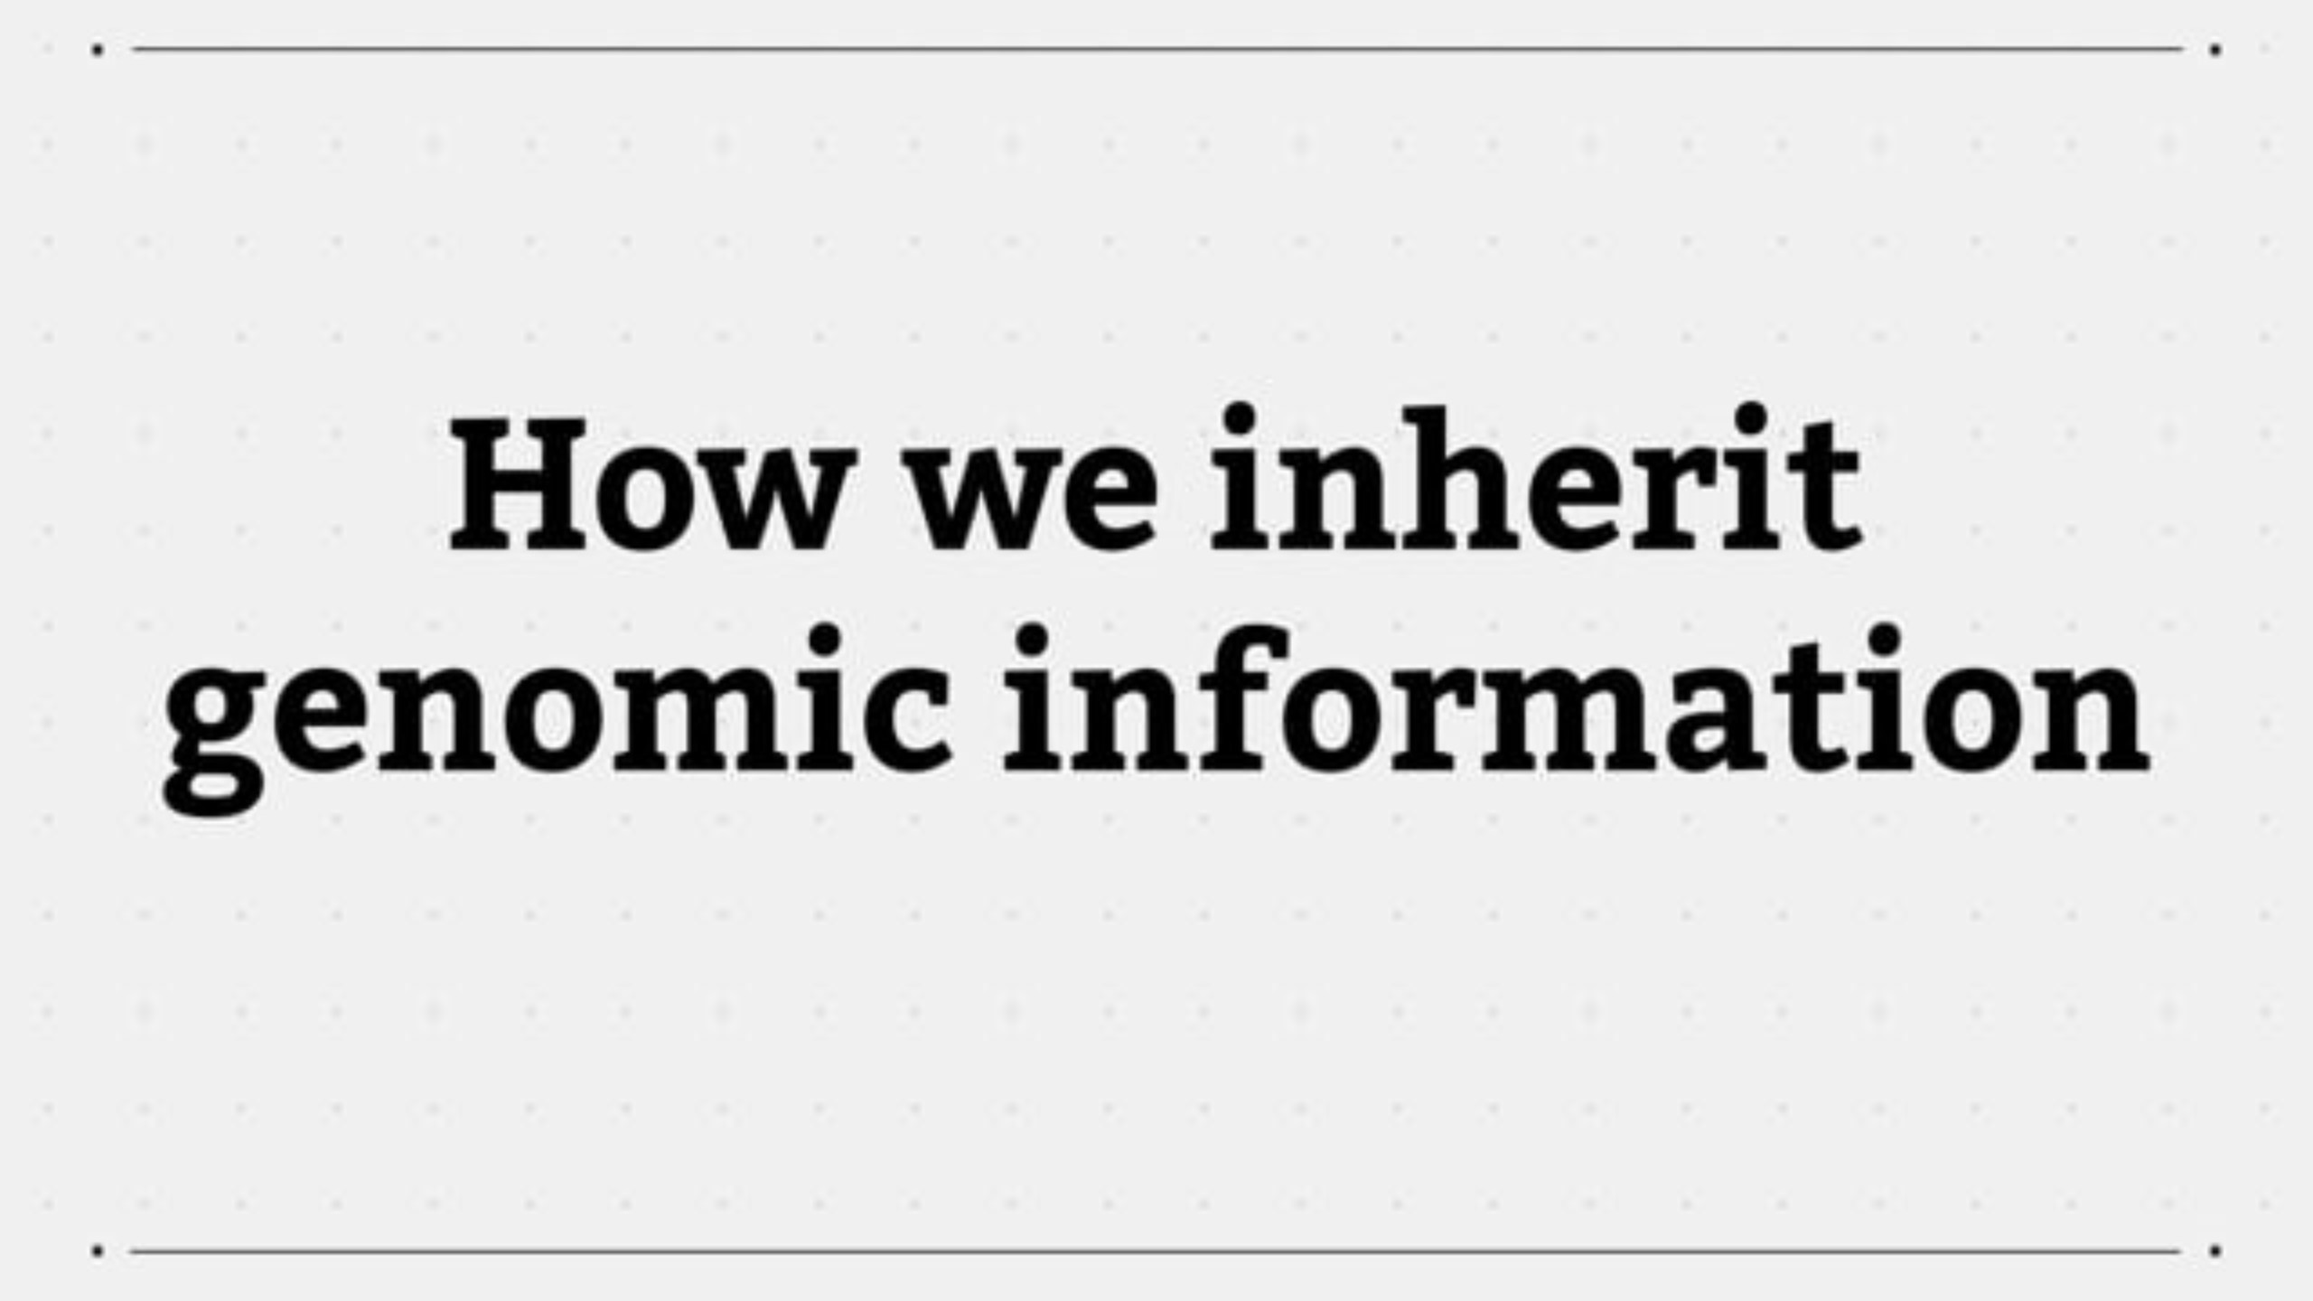

Slide 36
Genetic conditions
Sickle cell disease and Huntington disease are just two examples of inherited conditions.
Discussion: What are the implications of an inherited condition? In terms of condition management, how might inherited conditions differ from other medical conditions?
Notes:
Note to educator: For this discussion, prompt the learners to explore what the future looks like for a patient, who may be a child, and their family. How long will a patient have that condition. Is the condition easy to manage and live with? What lifestyle changes might need to be considered? How favourably does today’s society view people with that condition?
Ask questions to encourage comparisons between treatment and management for a genetic condition to that of non-genetic conditions. For example, sickle cell disease (genetic) vs sepsis (not genetic), or Duchenne muscular dystrophy (genetic) vs broken bones or sprains (not genetic).
You may also wish to think about the advantages and disadvantages of using genomics to predict the chances of family members developing a condition.

Slide 37
Genomic sequencing is:
creating a genome
reading a genome
alphabetising DNA
destroying DNA
Genomic sequencing is used to read, or map, an individual’s genome.

Slide 38
Why do people want to study the genome?
Scientific research
Health reasons
To trace ancestry
Lifestyle reasons
In healthcare, we want to improve prediction, prevention, diagnosis and treatment of disease.
For example, variations in our genome can indicate the likelihood of developing certain health conditions.

Slide 39
The variation in our genome can tell us:
if you will develop a condition
if you may develop a condition
how you may react to a drug
your ancestry
The 0.2% variation in our genomes tells us: if someone might develop a genetic condition, if they're more susceptible to a certain condition or disease, and how they may react to specific drugs or interventions.

Slide 40
Now that we’ve ‘read’ the human genome, we know everything about it.
True
False
It’s false. There are still things to discover in the human genome.

Slide 41
Genomes are ‘read’ via genomic sequencing
Genomic sequencing is used to ‘read’ or ‘map’ some or all of an individual’s genome.
We can now sequence a human genome in only days and for under £1,000.
Discussion: Do you know of any clinical scenarios where genomic sequencing is currently being used?
Notes:
Note to educator: Sickle cell disease and cystic fibrosis are two examples, but many exist. For this discussion, you may wish to note the National Genomic Test Directory, which has a list of all eligible genomic tests commissioned by the NHS in England, the technology by which they are available, and the types of patient who will be eligible.
More information:
The National Genomic Test Directory: www.england.nhs.uk/publication/national-genomic-test-directories/

Slide 42


Slide 43
We don’t know everything about genomes
Our genomes are huge and very complex.
Each genome is different.
We don’t understand everything about them, but we’re learning more all the time…
…to improve prediction, prevention, diagnosis and treatment of disease.

Slide 44
To investigate an individual’s genome, we need a sample of their DNA.
What biological samples will give us DNA?
Hair roots, skin cells, bone marrow, blood, tumour cells, faeces, saliva, . . .
Almost every cell in our body has a copy of our genome, so DNA can be extracted from all bodily tissues.

Slide 45
Genomic tests are available through the NHS, only.
True
False
Anyone can buy a direct-to-consumer testing (DTC) kit.
DTC results give information on ancestry or the presence of variants linked to a number of conditions.

Slide 46
NHS vs direct-to-consumer genomic tests
Anyone can buy a direct-to-consumer (DTC) testing kit.
Results may give insight into ancestry, traits or gene variants.
The interpretation of DTC results is often inconclusive.
Discussion: What advice would you give to an individual who had taken a DTC test and received unsettling results about variants linked to a particular condition?
Note: Always consult a healthcare professional to find out what DTC test results really mean.
Notes:
Note to educator: For this discussion, get the learners to think about how a patient seeing their primary care clinician (such as a GP) might be feeling if they have used an off-the-shelf test and received unsettling results. What could the clinician do to reassure the patient?

Slide 47
Only humans have a genome.
True
False
It’s false. Every living organism has a genome, from bacteria to human beings to plants.

Slide 48
Genomics is used in infectious disease outbreaks.
True
False
Pathogens, such as bacteria or viruses, have a genome too.
DNA sequencing allowed us to understand, track and develop measures against the Covid-19 virus.

Slide 49
Antibiotic resistance comes from mutations in bacteria’s DNA.
True
False
It’s true. Antibiotic resistance is due to DNA mutations in bacteria that help them survive an antibiotic.
A patient needs to complete their course of antibiotics to reduce the chance that the infection becomes resistant.

Slide 50
In an outbreak, we sequence the pathogen’s genome to:
identify number of infected
identify the outbreak’s source
identify the drug to use
identify the type of pathogen
Genomics can give information that can be used to control the pathogen’s spread and treat affected people.
We cannot tell, via genome sequencing, how many people have been infected.

Slide 51

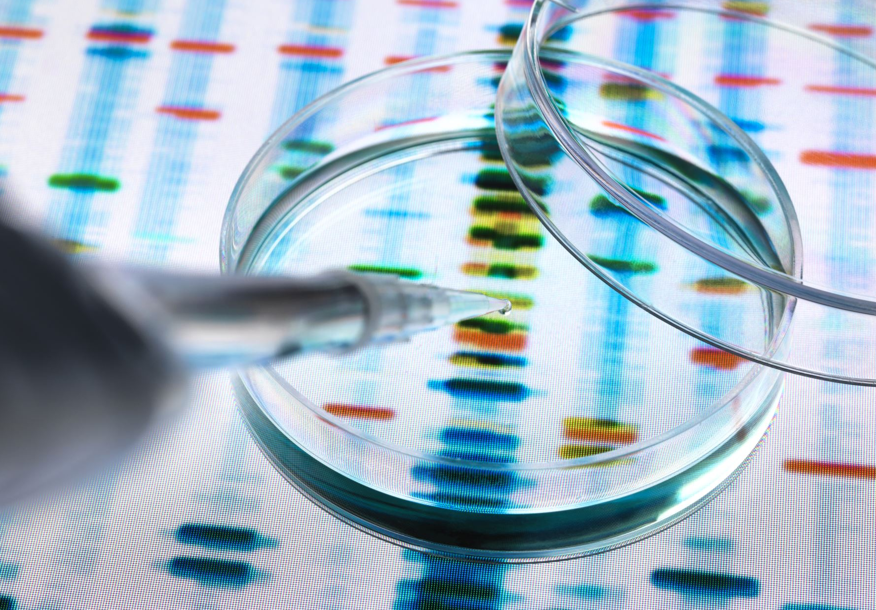
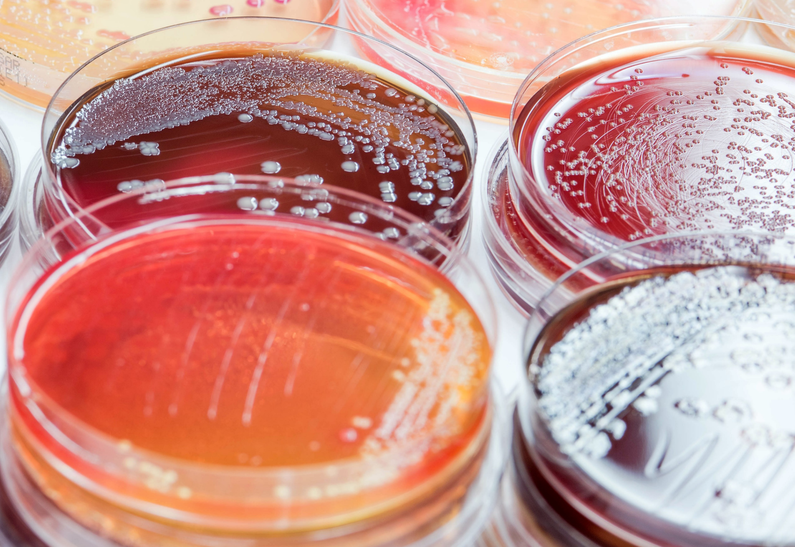
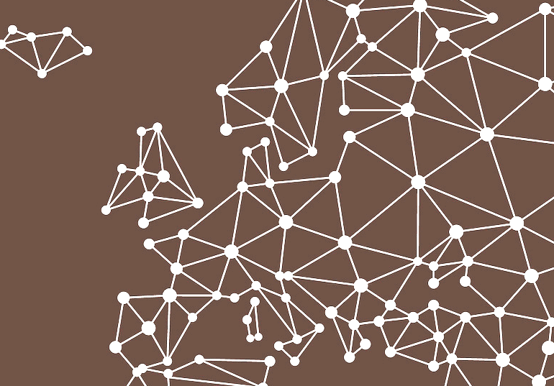

Whole genome sequencing (WGS) can trace disease
Four months later,
255 cases reported throughout Europe.
WGS was more accurate and quicker than traditional ways.
May 2014, England reports 32 cases of food poisoning.
WGS let experts understand how the outbreak moved.
Notes:
Note to educator: This story was published in 2015 in the scientific journal Eurosurveillance by a scientific teams at Public Health England (now the UK Health Security Agency) and the Food Standards Agency. Their report can be accessed at: https://doi.org/10.2807/1560-7917.ES2015.20.16.21098
Further reading on pathogen genomic screening, and more example use cases, can be read at: https://www.gov.uk/government/news/ukhsa-publishes-new-5-year-pathogen-genomics-strategy

Slide 52
Antibiotic resistance and bacterial genomes
Some antibiotics can no longer be used to treat certain infections.
Discussion: How is genomics playing a role in the effort against antimicrobial resistance? What might some of the advantages of using these genomic technologies?
Notes:
Note to educator: For this discussion, genomics also has a great potential in terms of targeted prescribing of antibiotics. For example, a genomic test can tell if bacteria sampled from a patient are resistant to specific antibiotics. Also, genomic technologies are quicker than culturing microbiology samples and so they may permit bedside testing. Finally, antibiotic resistant bacteria outbreaks can also be better tracked with genomics.

Slide 53
Cancer is a disease of the genome.
True
False
It’s true, cancer is a disease of the genome.
All cancers are as a result of changes to the genome.
Not all changes will lead to cancer.

Slide 54
A cancer cell’s genome looks the same as a healthy cell’s genome.
True
False
If you looked at a cancer cell’s genome, it would look different to the genome of a healthy cell.
Cancer occurs due to changes in the genome that cause a healthy cell to behave differently.

Slide 55

Cancer cells’ genomes look different to a healthy cell
3. If a mutational event stops a cell entering programmed cell death ...
Click to continue.
4. ... then mutations can accumulate …
Click to continue.
5. ... leading to a cancer with its own genome.
Click to end.
1. After division, a daughter cell’s genome may experience a mutational event.
Click to continue.
3. This keeps the tissue full of healthy cells with healthy genomes.
Click to continue.
2. Normally, if a cell’s genome is too badly damaged it will enter ‘programmed cell death’.
Click to continue.
Notes:
Note to educator: Click through this animation which visualises how mutational events in a cell's DNA may lead to tumours.

Slide 56
Sequencing a tumour’s genome tells us:
If the cancer is inherited
The type of cancer
Suitable treatment options
The stage the cancer is at
Sequencing the tumour’s genome tells us a lot about the cancer, like its type, stage and inform on potential treatment.
We would need to compare a patient’s ‘healthy’ genome to that of a relative to see if the cancer is a result of an inherited variant.

Slide 57
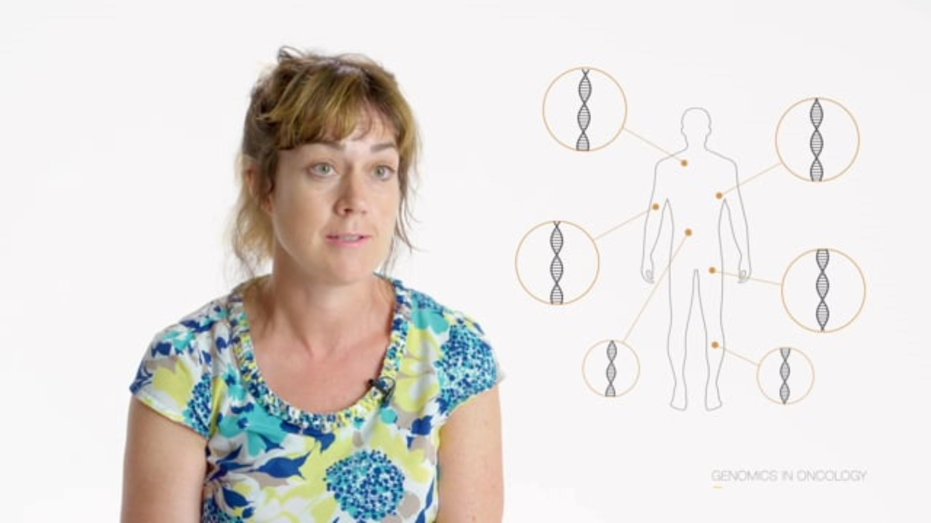

Slide 58
The word ‘familial’ in familial disease means the disease:
is related to diet
is related to family
is familiar to doctors
is due to a living situation
The word familial means that a disease or a condition occurs within families or family members.

Slide 59
In a clinical context, what is a family history?
Health details of an individual and their close relatives
A doctor’s photo album
Data on a family’s hospital visits
A patient’s ancestry information
It documents an individual’s health information and that of their close relatives.
A family history is usually presented in a pictorial diagram known as a genetic family tree, or pedigree.

Slide 60
It runs in the family
For every 100 diagnosed cancer cases, between 5 and 10 of them are thought to be due to an inherited genetic variant.
Discuss: Do you know of any inherited cancer syndromes?
hereditary breast cancer
hereditary ovarian cancer
Li-Fraumeni syndrome
Lynch syndrome
familial adenomatous polyposis
retinoblastoma
multiple endocrine neoplasia
among others …
Click to reveal answers.
Notes:
Note to educator: There are many, but some more common ones are listed.

Slide 61
A patient is worried about an inherited condition. Do you:
draw a family history
access the family’s medical records
meet with the patient’s immediate family
share the patient’s genetic results with family members
By drawing a family history of an individual and their close family members, it may be possible to identify patterns that could indicate an inherited condition.

Slide 62
In a family history, which has the least clinical value?
Biological relationships
Medical conditions
Relatives’ names
Relatives’ ages at death
All four can be recorded on a genetic family history, but the names of relatives are least important.
Genetic family histories can be used to identify if an inherited condition exists.

Slide 63
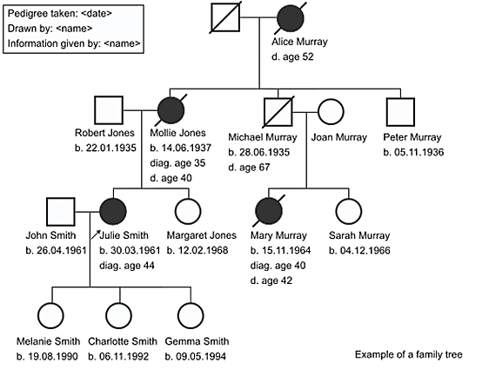
Often used symbols when taking a history
Male
Female
Deceased
Partners
Affected male
Affected female
Separated
Children &
siblings
Arrow points to proband

Slide 64
Which clinical clues may hint at a genetic condition?
An unusual presentation, for instance multiple symptoms
Young person with a condition that usually presents later in life
A step-parent who had the condition
A condition that ‘runs’ in families
Many signs or symptoms, which are referred to as
‘clinical clues’, can indicate an inherited condition.
As genetic information connects blood relatives,
a step-parent with the condition isn’t deemed a clinical clue.

Slide 65
Clinical clues from relatives who died young
Family history shows multiple relatives who died young.
Gives a clue that this family has an inherited type of cancer.
d: 49, PC
diag: 49,
PC
d: 50,
EC
d: 48,
EC

Slide 66
Family histories are valuable
Discuss: What other information might be valuable when drawing a family history?
Click to reveal answers.
Cause of death
Age at death
Relationships
Consanguinity
Family medical conditions
Anything that helps achieve diagnosis
Notes:
Note to educator: For this discussion, any information that helps a clinician reach a diagnosis is good information to have.

Slide 67
Results from a genetic test will have clinical implications for the patient, only.
True
False
A genetic test result may have a wider impact than that of other medical tests.
Genomic information is shared between blood relatives, so a test result may reveal a condition that may affect them.

Slide 68
Angelina Jolie chose to have a double mastectomy based on a genetic diagnosis.
True
False
The actor, Angelina Jolie, chose to have preventative surgery based on a genetic test.
The test had revealed a gene variation that increased the actor’s chance of developing breast cancer.

Slide 69
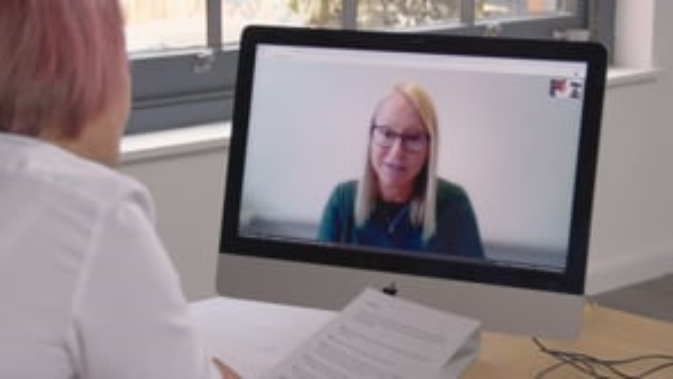

Slide 70
Patients make choices based on genetic tests
In 2013, actor Angelina Jolie chose to have a double mastectomy.
Her preventative surgery was based on a genetic test.
The test had revealed she had a gene variant that raises her chance of developing breast cancer.
Discussion point: How can media stories raise awareness around genomics? Are there any others you know of?
Notes:
Note to educator: Media stories can get people talking about something, which may remove the taboo and get people seeing clinicians. Chris Hemsworth (Thor in the Marvel movies) discovered he has an APOE4 gene variant which is connected to Alzheimer’s disease. Journalist Krishnan Guru-Murthy has hypertrophic cardiomyopathy which is a genetic heart condition.
More information:
- Chris Hemsworth’s APOE4 diagnosis: www.genomicseducation.hee.nhs.uk/blog/marvel-star-goes-public-on-his-apoe-genetic-link-to-alzheimers/
- Krishnan Guru-Murthy’s hypertrophic cardiomyopathy diagnosis: https://virginradio.co.uk/entertainment/119068/strictly-2023-krishnan-guru-murthy-doctors-health-concerns

Slide 71
A patient’s genomic information should always be handled sensitively.
How can sensitive data be protected?
Firewalls and encryption
Storing data away from personal identifiers
Restricting and monitoring access to data
Robust consent process

Slide 72
Protect sensitive data
An individual’s genomic data is treated with the same sensitivity and confidentiality as other medical information.
Discuss: Since genetic information is shared between family members, why might some be more concerned about how this data is used?
Notes:
Note to educator: For this discussion, encourage the learners to think about ramifications of genomic data, how it is stored and who might use or access it. For example, years after it was taken from a crime scene, DNA was eventually matched against some stored data the killer’s family members had sent in for DNA-based ancestry testing. This led to the killer being arrested.
In terms of health insurance, should a family member discover they have a genetic condition, your own premiums and costs might increase as the company will assume you have something similar.
Additional information: Since 2018, the Code on Genetic Testing and Insurance, which is an agreement between our government and the Association of British Insurers (ABI), states that predictive genetic test results are not taken into account, unless the life insurance is over £500,000 and the applicant has had a predictive test for Huntington disease. However, the increasing use of genomics as a predictive tool means this agreement is regularly reviewed and may change in the future.
The Code on Genetic Testing and Insurance can be found at: www.abi.org.uk/data-and-resources/tools-and-resources/genetics/code-on-genetic-testing-and-insurance/

Slide 73
Which best defines the word ‘pharmacogenomics’?
A type of gene therapy
A treatment involving changing a person’s genome
A type of intervention that produces no side effects
Using genomics to tailor drug treatment for individuals
Genetic and genomic information can be used to tailor pharmaceutical therapies to each individual.
The patient’s genome can tell us the drug and dose combination most effective for them.

Slide 74








About pharmacogenomics
How our body responds to some drugs depends on our genome. What works for you might not work for another.
…works.
…works.
…doesn’t work.
No side
effects…
…doesn’t work.
Side
effects…
Notes:
Note to educator: This animation visualises four possible outcomes that help define pharmacogenomics. They are:
- Drug gives side effects but works.
- Drug gives side effects but does not work.
- Drug does not have side effects and works.
- Drug does not have side effects does not work.

Slide 75
A patient’s genomic information is the only factor considered for precision medicine.
True
False
It’s false. Precision medicine describes treatment or care specifically tailored to the individual.

Slide 76
Precision medicine encompasses everything
Information, such as current health, lifestyle and genomic factors, is used to make sure the individual is receiving the right treatment, at the right time, at the right dose.
Discuss: In addition to genomics, what other health information will also be taken into account when making prescribing decisions?
Notes:
Note to educator: For this discussion, think about the patient as a whole (holistically), from genomics to lifestyle to the environment they live in. For most clinical situations genomics is only one part of the puzzle. More often there is an interplay between the variation in our genome and other non-genetic factors.

Slide 77


Slide 78
Thank you for taking part in
The Genomics Game (quiz)
If you found it useful, consider letting your education and training colleagues know about this resource.
We welcome any and all feedback or comments.
Please contact us.

