Slide 1
The Genomics Game (Online)
About
This is an educational quiz to support educators teach genomic concepts, and their applications in healthcare, in a fun and engaging way.
The quiz can be used as a standalone resource or as an adjunct to support and complement other educational activities.
Educators of all healthcare professions may find this quiz useful.

Slide 2
The quiz comes in two slide decks
Both slide decks (and supplementary materials) can be accessed through this NHS England Genomics Education Programme webpage.
Slide deck 1 of 2 has the following themed sections:
Slide deck 2 of 2 has the following themed sections:
About DNA
Chromosomes
Genes vs genomes
Genomes to proteins
Inheritance and variation
Research and techniques
Diagnostics
Infections and genomics
Cancer genomics
Family history
How results are far reaching
Precision medicine (and pharmacogenomics)

Slide 3
Slides in sections for easy configuration
1) Slide sections.
These keep slide groupings together.
2) Each section has complimentary:
- red-question slides, and - blue-information slides.

Slide 4
About the slides
The red-question slides – there are over 40 around various genomic themes – also provide information through the box.
The blue-information slides give further information or context to the previous question slides. Some have discussion points.

Slide 5
Discussions
Some blue-information slides, like this one, have a structured prompt discussion points (seen in the picture in pink).
Discussions keep learners active during delivery, encourage critical thinking as well as other benefits.
To help you facilitate a group discussion, notes to the educator are provided. These are found both in the slide notes.

Slide 6
How to present these slides
Use the complete slide deck as presented here (we recommend removing this ‘read-me’ section first).
or
Insert individual slides into your own presentation. To do this:
Highlight slides you wish to use.
Copy slides.
Paste, keeping source formatting ( ), into your own PowerPoint file.
For support, see the tutorial video on the next slide or access Microsoft’s help webpage.
For the best experience, present the slides as a slide show.
For a how-to on this, please see this Microsoft help webpage.

Slide 7
Video: Copy slides into your presentation

Slide 8
The Genomics Game (online)
Based on The Genomics Game for in-person learning (found online here), this quiz resource supports the delivery of genomics education in an online learning environment.
This quiz was made by NHS England’s Genomics Education Programme.
Slide deck 2 of 2.

Slide 9
Continued from part 1 which covers
About DNA
Chromosomes
Genes vs genomes
Genomes to proteins
Inheritance and variation
Research and techniques
Diagnostics
If you have not already downloaded part 1, you can grab it from this Genomics Education Programme webpage.

Slide 10
Only humans have a genome.
True
False
It’s false. Every living organism has a genome, from bacteria to human beings to plants.

Slide 11
Genomics is used in infectious disease outbreaks.
True
False
Pathogens, such as bacteria or viruses, have a genome too.
DNA sequencing allowed us to understand, track and develop measures against the Covid-19 virus.

Slide 12
Antibiotic resistance comes from mutations in bacteria’s DNA.
True
False
It’s true. Antibiotic resistance is due to DNA mutations in bacteria that help them survive an antibiotic.
A patient needs to complete their course of antibiotics to reduce the chance that the infection becomes resistant.

Slide 13
In an outbreak, we sequence the pathogen’s genome to:
identify number of infected
identify the outbreak’s source
identify the drug to use
identify the type of pathogen
Genomics can give information that can be used to control the pathogen’s spread and treat affected people.
We cannot tell, via genome sequencing, how many people have been infected.

Slide 14
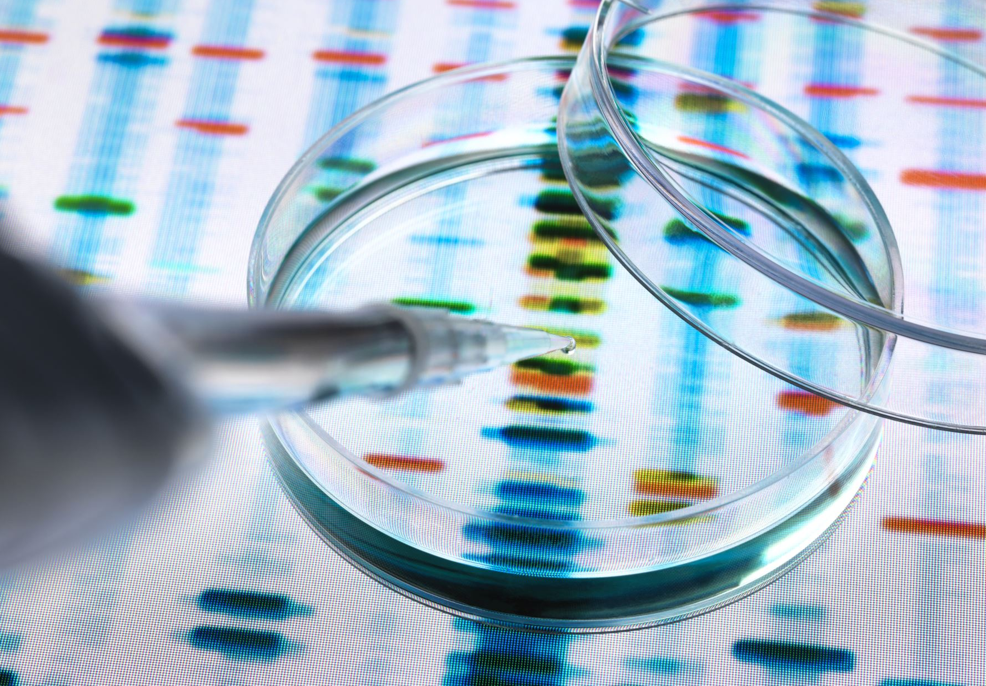
Whole genome sequencing (WGS) can trace disease
Four months later,
255 cases reported throughout Europe.
WGS was more accurate and quicker than traditional ways.
May 2014, England reports 32 cases of food poisoning.
WGS let experts understand how the outbreak moved.
Notes:
Note to educator: This story was published in 2015 in the scientific journal Eurosurveillance by a scientific teams at Public Health England (now the UK Health Security Agency) and the Food Standards Agency. Their report can be accessed at: https://doi.org/10.2807/1560-7917.ES2015.20.16.21098
Further reading on pathogen genomic screening, and more example use cases, can be read at: https://www.gov.uk/government/news/ukhsa-publishes-new-5-year-pathogen-genomics-strategy

Slide 15
Antibiotic resistance and bacterial genomes
Some antibiotics can no longer be used to treat certain infections.
Discussion: How is genomics playing a role in the effort against antimicrobial resistance? What might some of the advantages of using these genomic technologies?
Notes:
Note to educator: For this discussion, genomics also has a great potential in terms of targeted prescribing of antibiotics. For example, a genomic test can tell if bacteria sampled from a patient are resistant to specific antibiotics. Also, genomic technologies are quicker than culturing microbiology samples and so they may permit bedside testing. Finally, antibiotic resistant bacteria outbreaks can also be better tracked with genomics.

Slide 16
Cancer is a disease of the genome.
True
False
It’s true, cancer is a disease of the genome.
All cancers are as a result of changes to the genome.
Not all changes will lead to cancer.

Slide 17
A cancer cell’s genome looks the same as a healthy cell’s genome.
True
False
If you looked at a cancer cell’s genome, it would look different to the genome of a healthy cell.
Cancer occurs due to changes in the genome that cause a healthy cell to behave differently.

Slide 18
Cancer cells’ genomes look different to a healthy cell
3. If a mutational event stops a cell entering programmed cell death ...
Click to continue.
4. ... then mutations can accumulate …
Click to continue.
5. ... leading to a cancer with its own genome.
Click to end.
1. After division, a daughter cell’s genome may experience a mutational event.
Click to continue.
3. This keeps the tissue full of healthy cells with healthy genomes.
Click to continue.
2. Normally, if a cell’s genome is too badly damaged it will enter ‘programmed cell death’.
Click to continue.
Notes:
Note to educator: Click through this animation which visualises how mutational events in a cell's DNA may lead to tumours.

Slide 19
Sequencing a tumour’s genome tells us:
If the cancer is inherited
The type of cancer
Suitable treatment options
The stage the cancer is at
Sequencing the tumour’s genome tells us a lot about the cancer, like its type, stage and inform on potential treatment.
We would need to compare a patient’s ‘healthy’ genome to that of a relative to see if the cancer is a result of an inherited variant.

Slide 20
Video: How genomics is used in cancer care
online, via Vimeo

Slide 21
The word ‘familial’ in familial disease means the disease:
is related to diet
is related to family
is familiar to doctors
is due to a living situation
The word familial means that a disease or a condition occurs within families or family members.

Slide 22
In a clinical context, what is a family history?
Health details of an individual and their close relatives
A doctor’s photo album
Data on a family’s hospital visits
A patient’s ancestry information
It documents an individual’s health information and that of their close relatives.
A family history is usually presented in a pictorial diagram known as a genetic family tree, or pedigree.

Slide 23
It runs in the family
For every 100 diagnosed cancer cases, between 5 and 10 of them are thought to be due to an inherited genetic variant.
Discuss: Do you know of any inherited cancer syndromes?
hereditary breast cancer
hereditary ovarian cancer
Li-Fraumeni syndrome
Lynch syndrome
familial adenomatous polyposis
retinoblastoma
multiple endocrine neoplasia
among others …
Click to reveal answers.
Notes:
Note to educator: There are many, but some more common ones are listed.

Slide 24
A patient is worried about an inherited condition. Do you:
draw a family history
access the family’s medical records
meet with the patient’s immediate family
share the patient’s genetic results with family members
By drawing a family history of an individual and their close family members, it may be possible to identify patterns that could indicate an inherited condition.

Slide 25
In a family history, which has the least clinical value?
Biological relationships
Medical conditions
Relatives’ names
Relatives’ ages at death
All four can be recorded on a genetic family history, but the names of relatives are least important.
Genetic family histories can be used to identify if an inherited condition exists.

Slide 26
Often used symbols when taking a history
Male
Female
Deceased
Partners
Affected male
Affected female
Separated
Children &
siblings
Arrow points to proband

Slide 27
Which clinical clues may hint at a genetic condition?
An unusual presentation, for instance multiple symptoms
Young person with a condition that usually presents later in life
A step-parent who had the condition
A condition that ‘runs’ in families
Many signs or symptoms, which are referred to as ‘clinical clues’, can indicate an inherited condition.
As genetic information connects blood relatives, a step-parent with the condition isn’t deemed a clinical clue.

Slide 28
Clinical clues from relatives who died young
Family history shows multiple relatives who died young.
Gives a clue that this family has an inherited type of cancer.
d: 49, PC
diag: 49,
PC
d: 50,
EC
d: 48,
EC

Slide 29
Family histories are valuable
Discuss: What other information might be valuable when drawing a family history?
Click to reveal answers.
Cause of death
Age at death
Relationships
Consanguinity?
Family medical conditions
Anything that helps achieve diagnosis
Notes:
Note to educator: For this discussion, any information that helps a clinician reach a diagnosis is good information to have.

Slide 30
Results from a genetic test will have clinical implications for the patient, only.
True
False
A genetic test result may have a wider impact than that of other medical tests.
Genomic information is shared between blood relatives, so a test result may reveal a condition that may affect them.

Slide 31
Angelina Jolie chose to have a double mastectomy based on a genetic diagnosis.
True
False
The actor, Angelina Jolie, chose to have preventative surgery based on a genetic test.
The test had revealed a gene variation that increased the actor’s chance of developing breast cancer.

Slide 32
Video: The impact on families
online, via Vimeo

Slide 33
Patients make choices based on genetic tests
In 2013, actor Angelina Jolie chose to have a double mastectomy.
Her preventative surgery was based on a genetic test.
The test had revealed she had a gene variant that raises her chance of developing breast cancer.
Discussion point: How can media stories raise awareness around genomics? Are there any others you know of?
Notes:
Note to educator: Media stories can get people talking about something, which may remove the taboo and get people seeing clinicians. Chris Hemsworth (Thor in the Marvel movies) discovered he has an APOE4 gene variant which is connected to Alzheimer’s disease. Journalist Krishnan Guru-Murthy has hypertrophic cardiomyopathy which is a genetic heart condition.
More information:
- Chris Hemsworth’s APOE4 diagnosis: www.genomicseducation.hee.nhs.uk/blog/marvel-star-goes-public-on-his-apoe-genetic-link-to-alzheimers/
- Krishnan Guru-Murthy’s hypertrophic cardiomyopathy diagnosis: https://virginradio.co.uk/entertainment/119068/strictly-2023-krishnan-guru-murthy-doctors-health-concerns

Slide 34
A patient’s genomic information should always be handled sensitively.
How can sensitive data be protected?
Firewalls and encryption
Storing data away from personal identifiers
Restricting and monitoring access to data
Robust consent process

Slide 35
Protect sensitive data
An individual’s genomic data is treated with the same sensitivity and confidentiality as other medical information.
Discuss: Since genetic information is shared between family members, why might some be more concerned about how this data is used?
Notes:
Note to educator: For this discussion, encourage the learners to think about ramifications of genomic data, how it is stored and who might use or access it. For example, years after it was taken from a crime scene, DNA was eventually matched against some stored data the killer’s family members had sent in for DNA-based ancestry testing. This led to the killer being arrested.
In terms of health insurance, should a family member discover they have a genetic condition, your own premiums and costs might increase as the company will assume you have something similar.
Additional information: Since 2018, the Code on Genetic Testing and Insurance, which is an agreement between our government and the Association of British Insurers (ABI), states that predictive genetic test results are not taken into account, unless the life insurance is over £500,000 and the applicant has had a predictive test for Huntington disease. However, the increasing use of genomics as a predictive tool means this agreement is regularly reviewed and may change in the future.
The Code on Genetic Testing and Insurance can be found at: www.abi.org.uk/data-and-resources/tools-and-resources/genetics/code-on-genetic-testing-and-insurance/

Slide 36
Which best defines the word ‘pharmacogenomics’?
A type of gene therapy
A treatment involving changing a person’s genome
A type of intervention that produces no side effects
Using genomics to tailor drug treatment for individuals
Genetic and genomic information can be used to tailor pharmaceutical therapies to each individual.
The patient’s genome can tell us the drug and dose combination most effective for them.

Slide 37
About pharmacogenomics
How our body responds to some drugs depends on our genome. What works for you might not work for another.
…works.
…works.
…doesn’t work.
No side
effects…
…doesn’t work.
Side
effects…
Notes:
Note to educator: This animation visualises four possible outcomes that help define pharmacogenomics. They are:
- Drug gives side effects but works.
- Drug gives side effects but does not work.
- Drug does not have side effects and works.
- Drug does not have side effects does not work.

Slide 38
A patient’s genomic information is the only factor considered for precision medicine.
True
False
It’s false. Precision medicine describes treatment or care specifically tailored to the individual.

Slide 39
Precision medicine encompasses everything
Information, such as current health, lifestyle and genomic factors, is used to make sure the individual is receiving the right treatment, at the right time, at the right dose.
Discuss: In addition to genomics, what other health information will also be taken into account when making prescribing decisions?
Notes:
Note to educator: For this discussion, think about the patient as a whole (holistically), from genomics to lifestyle to the environment they live in. For most clinical situations genomics is only one part of the puzzle. More often there is an interplay between the variation in our genome and other non-genetic factors.

Slide 40
Video: The realisation of personalised medicine
online, via Vimeo

Slide 41
Thank you for taking part in The Genomics Game (Online)
If you found it useful, consider letting your education and training colleagues know about this resource.
We welcome any and all feedback or comments.
Please contact us.

