Slide 1


Introducing GeNotes

Slide 2
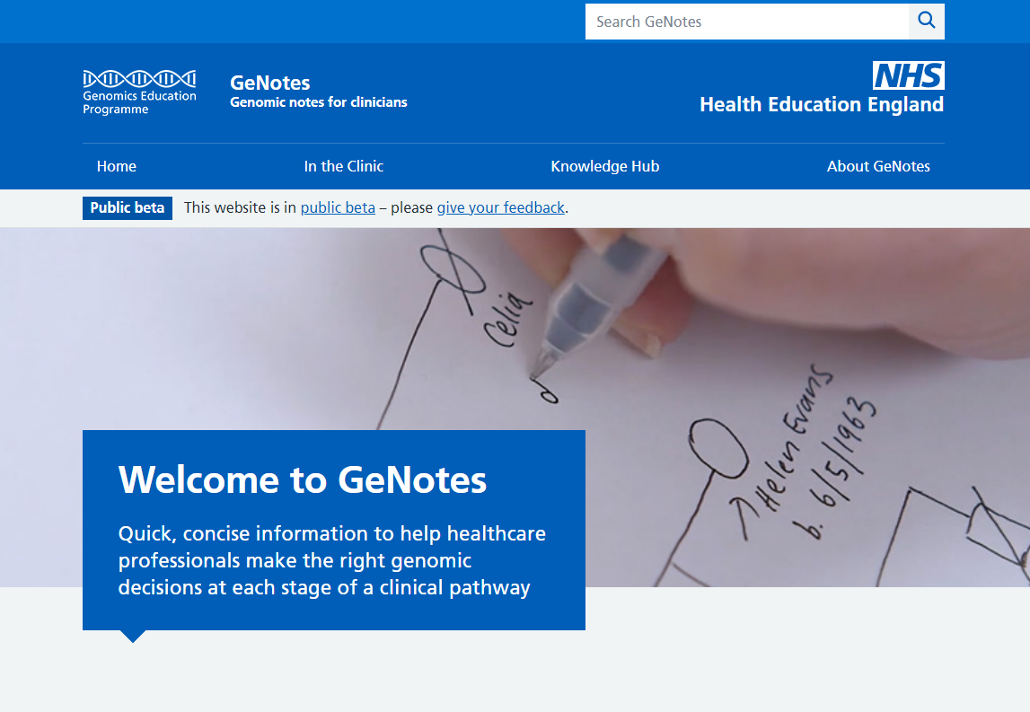
Background and features
Two-tier online
educational resource.
Developed by clinicians for clinicians.
Aims to support the clinician at the point of need (reactive learning), with opportunities to build genomics knowledge (proactive learning).

Slide 3
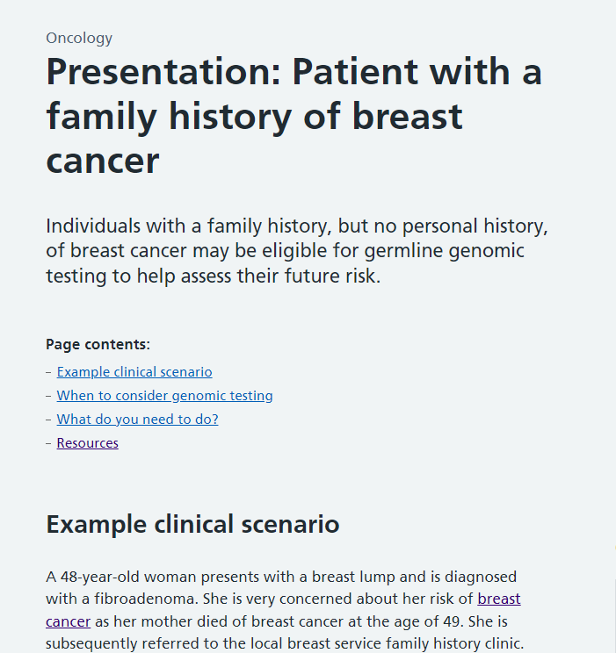
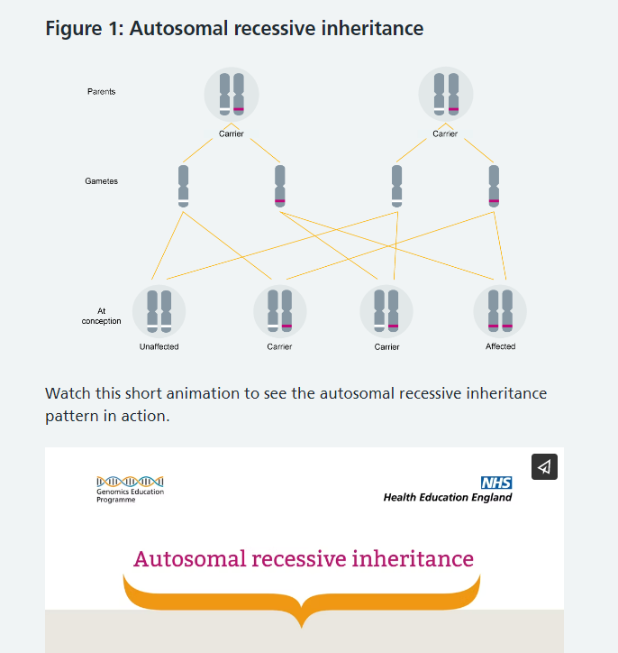
Background and features
Aligns to the national priorities as outlined in Genome UK.
A named commitment in the 2022 England Rare Disease Action Plan.
Website underpinned by API to allow for content syndication.
NHS/HEE branding reassures users that a trusted resource.
Free to access for all NHS staff.

Slide 4
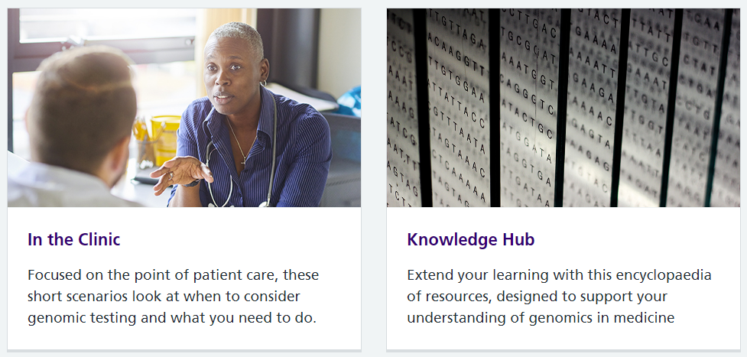
Two tiers of content

Slide 5
Structure
Tier 1 (In the Clinic)
  Aligned to the test directory.
  Follow a strict template.
  Built around clinical scenarios that educate on when and how to undertake genomic testing.
Tier 2 (Knowledge Hub)
  Can be accessed via links in the tier 1 resources or independently.
  Agnostic learning – suitable for many/all specialties and professional groups.
Tier 1
Tier 2
Extended learning 1
Scenario 1
Extended learning 2
Extended learning 3
Scenario 2
Extended learning 4
Extended learning 5

Slide 6
Achievements so far
Completed concept development and alpha testing phases in 2020.
Private beta testing in 2021/22 for Oncology, Paediatrics and Primary Care.
90/100 usability score (industry average 68) with hugely positive feedback, eg:
  “It’s just very user friendly. Very clear, uncluttered. Just the information
  I want to see. I think it’s excellent.”
  “What works well? I think it’s the clarity of the writing.”
  “Am I likely to use GeNotes in the future? Definitely, 100%.”
Public beta live June 2022, with 28 Oncology tier 1s and 62 cross-specialty tier 2s.
1,500+ visitors and 5,300+ page views in first 60 days.
Further feedback via public beta online forms, eg:
  “The Knowledge Hub will be an excellent resource, thank you!”

Slide 7
Content governance
Multi-regional (all GMSAs involved), multi-professional, multi-specialty.
Underpinned by working groups from mainstream specialties with
Clinical Genetics support, each at various stages of development:
Funding allocated to remunerate working group writers and reviewers.
Published content regularly reviewed and updated.
  Cardiology
  Endocrinology
  Haemato-Oncology
  Monogenic diabetes
  Oncology
  Paediatrics
  Primary Care
  Nephrology
  Neurology
  Pharmacogenomics
  Women’s and Fetal Health

Slide 8
Content creation
Robust writing and review process to ensure high quality and accuracy.
Review stages vary across working groups, but typically:
1. Specialty writing
2. Clinical genetics review
3. Speciality consultant review
4. Clinical genetics consultant review
5. Editorial review and publishing
Content development supported by GEP education, editorial, design, digital, project management and administrative teams.

Slide 9

Opportunities to get involved
Explore GeNotes:
www.genomicseducation.hee.nhs.uk/genotes
Give your feedback:
www.genomicseducation.hee.nhs.uk/genotes/beta-feedback/
Identified a learning need? Want to join or suggest a working group? Contact us: projectcoordinator.genomicseducation@hee.nhs.uk
Stay up-to-date with latest GeNotes and GEP news:
www.genomicseducation.hee.nhs.uk/newsletter-sign-up/

