Slide 1
Facilitating genomic testing: a competency framework
Slide deck for education and training
These slides have been developed by the Genomics Education Programme and can be adapted and used for local education and training about facilitating genomic testing in the NHS.
To view the full competency framework, visit:
www.genomicseducation.hee.nhs.uk/consent-a-competency-framework/

Slide 2
Background
Advances in genomic technology and its applications to clinical care have led to increased use of genomic testing across a growing number of specialties.
The way that genomic testing will be accessed in the NHS is changing, with the implementation of a Genomic Medicine Service (GMS) including a National Genomic Test Directory.
Whole genome sequencing will be available for certain rare disease indications and cancers, involving a ‘patient choice’ process of consent including a research offer within the clinical pathway.
There is therefore a growing need to provide a framework to support the development of the workforce who will be having conversations about genomic testing with patients.
Notes:
General background information that can be included in broader presentations

Slide 3
The framework
Identifies the core competencies required to facilitate and consent patients for germline genomic tests.
Developed by the Genomics Education Programme in collaboration with healthcare professionals from across the NHS.
Designed as a guide for best practice for healthcare professionals offering various genomic tests, and as a development tool to support individuals and organisations.
Benchmarked against four broad categories of healthcare professionals based on training and experience with genomics.
The competencies should be interpreted in the context in which a healthcare professional is offering genomic testing, considering their scope of practice. It is not indented to be used as a grading or an assessment tool.
For more information about the framework, how it was developed, and how it can be used, please see the GEP website.
Notes:
Useful information and context to set out

Slide 4
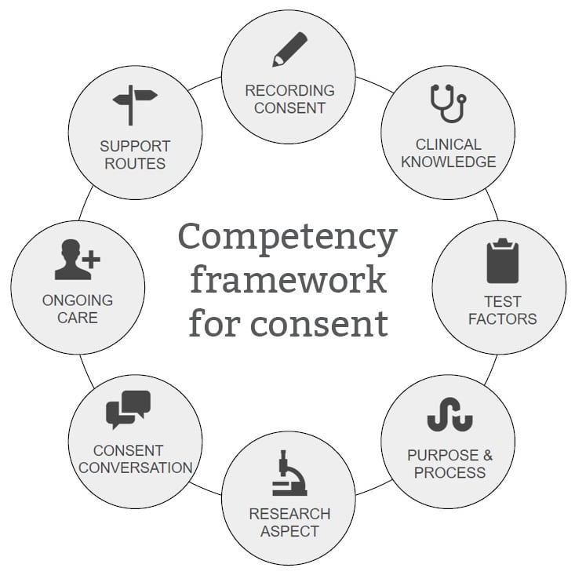
The competencies
Notes:
General overview slide

Slide 5
The competency framework
High-level competencies
Ensures the process of recording consent for a genomic test follows national and local processes and governance arrangements and is appropriate for the test being requested.
Demonstrates up-to-date knowledge of the conditions occurring within their specialist area for which genetic or genomic testing may be offered.
Assesses where genomic testing is appropriate in the patient’s clinical pathway
Conveys to patients the purpose and process of the clinical test being offered.
Explains and answers questions relating to the National Genomic Research Library where applicable.
Applies core clinical skills to the genomic test conversation.
Recognizes one’s ongoing responsibilities to the patient and acts when appropriate.
Seeks further assistance where relevant based on scope of practice.
Designed as a guide for best practice and development tool to support individuals and organisations.
Each competency is provided with links to supporting evidence-based educational resources.
Professional judgement based on an individual’s scope of practice should be considered.
www.genomicseducation.hee.nhs.uk/consent-a-competency-framework/
Notes:
General overview slide

Slide 6
1. Ensures the process of recording consent for a genomic test follows national and local processes and governance arrangements, and is appropriate for the test being requested
Demonstrates familiarity with the National Genomic Test Directory and adheres to this guidance when offering genomic testing, including the funding model, sample requirements and local requesting pathways.
Understands the national and local processes for changes to consent (i.e. at age 16 with capacity, for additional tests, when a patient changes their mind about having the test).
Demonstrates familiarity with principles of the Human Tissue Act 2004, Data Protection Act 2018 and/or General Data Protection Regulation 2018 as they apply to the use of DNA and genomic data.

Slide 7
2. Demonstrates up-to-date knowledge of the conditions occurring within their specialist area for which genetic or genomic testing may be offered
Understands general genetic concepts, the inheritance and mechanism of disease.
Is able to elicit a family history to assess the risk of one or more conditions.
Understands how conditions may present and the variability of clinical presentations.
Knows the likelihood of the patient’s presenting condition having a genetic basis, versus other possible factors (i.e. behavioural, social, environmental) that may contribute.
Recognises the different implications of somatic versus germline analysis.

Slide 8
3. Assesses where genomic testing is appropriate in the patient’s clinical pathway
Knows why a test may or may not be offered.
Considers ethnic and/or population-specific factors that may influence the type of test being offered.
Is aware of alternative tests to the genomic test being offered, if applicable.
Knows of possible future test options and choices, pending the results.
Recognises when it would be appropriate to offer genetic testing to children.

Slide 9
4. Conveys to patients the purpose and process of the clinical test being offered
Explains the context of the test (diagnostic, predictive or carrier).
Outlines the scope and limitations of the test based on the technology being used.
Explains the possible results and the turn-around time and feedback process for any results.
Describes the potential relevance of the test for that patient/family, including clinical actions that may or may not be taken.
Explains possible unexpected results (incidental findings).
Describes the potential uncertainty of genomic information, and the iterative nature of analysing results.
Describes how samples and data may be used, stored and accessed.
Outlines the familial implications of results and the importance of sharing results with relatives.
Understands the Code on Genetic Testing and Insurance.

Slide 10
5. Explains and answers questions relating to the National Genomic Research Library* where applicable
Outlines the potential benefits and risks of data and sample use, storage and sharing on personal, familial and societal levels.
Describes how samples and data may be used, stored and accessed.
Explains the process of partial or complete withdrawal of consent for research at any time.
* Based on research offer in the 100,000 Genomes Project, and initially only applicable to whole genome sequencing indications in the Genomic Medicine Service.

Slide 11
6. Applies core clinical skills to the genomic test conversation
Assesses capacity according to the Mental Capacity Act 2005 and other guidelines (such as Gillick competency).
Establishes the patient’s understanding and expectations of the genomic test being offered.
Employs effective communication skills to support decision making and enable patients to make a choice without coercion or bias.
Tailors provision of information based on the patient’s cognitive ability, age and language.
Engages with all individuals present in the discussion and incorporates the potentially different views of family members.
Addresses the psychosocial impact of genomic testing and risk, taking into consideration the impact of disease on the individual and/or family.
Considers the factors that may influence an individual’s choice to consent, including additional physical and mental health history; cultural, religious, familial and personal values; and timing of the conversation with respect to the patient’s care and/or other life events.
Respects the patient’s right to decline the genomic test, and is able to explain potential implications, limitations, and/or alternatives for the patient’s care.

Slide 12
7. Recognises one’s ongoing responsibilities to the patient and acts when appropriate
Understands that duty of care may extend beyond the initial feedback of genomic findings.
Is able to inform relevant professionals involved in managing the patient’s care and initiate onward referrals to other specialists.
Knows of patient resources, support groups, and eligibility criteria for research (where applicable).

Slide 13
8. Seeks further assistance, where relevant, based on scope of practice
Knows how to contact their local genomics laboratory, Clinical Genetics service and multidisciplinary review meetings if relevant.
Can recognise and understand one’s professional responsibilities and boundaries, and when to refer to relevant specialists for further support or patient management.
Knows how to access educational resources to support learning where relevant (such as Good Clinical Practice training and Genomics Education Programme courses).

Slide 14
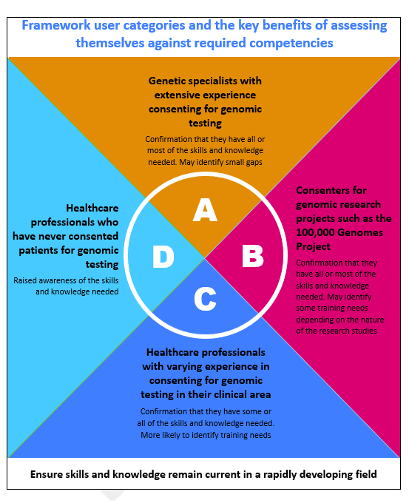



Evaluation of short-term outcomes
239 online survey responses from current or potential users (e.g. medical professionals, genetic counsellors, nurses, educationalists)
3 semi-structured interviews with regional education leads
Analysis of web usage statistics
Conclusions and recommendations:
This framework addresses a genuine and timely need among current and potential users.
The evaluation identified ways to improve promotion and accessibility for different healthcare professional user groups.
Further assessment of the different requirements of users within each category, as well as those involved in education, would be beneficial.
Work carried out by NHS Solutions for Public Health, 2020
Notes:
Summary of short-term evaluation work:
In January-March 2020, and external evaluation was carried out to assess how early adopters are using or intending to use the framework, determine enablers and barriers, and identify any additional resource requirements.
This included three semi-structured interviews with regional genomic education leads tied to the GLHs, 239 online survey responses, and analysis of web usage statistics for the framework’s page.
Responses and outcomes were considered in the context of four user categories – broadly defining health care professionals’ experience with genetic testing.
The evaluation concluded that this framework does addresses a timely need among current and potential users, with the introduction of a Test Directory.
It also identified ways to improve promotion and accessibility for different healthcare professional groups.
The GEP have utilised findings to add additional resources to support the use of the framework as a result, including publishing case studies of how it has been used in practice, and have been developing a suite of short online courses about facilitating genomic testing for HCPs where this may be new or wanting to refresh their knowledge and skills. The GEP are also looking into how to encourage awareness of the framework, including with professional colleges as many respondents felt it would be easier to adopt if their medical or nursing college had approved or was promoting this.
The GEP are planning future evaluations will assess ways the framework is being used, whether there is a demonstrated improvement in competence, and further resources that may be beneficial.

Slide 15
How could the framework be used?
Individual clinicians:
Identify learning needs as part of ongoing reflective practice​
Those delivering training: ​
Identify training needs of healthcare professional groups​
Structure training sessions​
Medical/professional colleges:
Consider adopting for use in under/post-graduate training
Those developing resources:
Highlight where there is a need for further resources
Notes:
Highlighting ways that the framework can be used by different individuals or groups

Slide 16
National links and resources
NHS information:
NHS Genomic Medicine Service
National Genomic Test Directory
NHS Genetic Services
NHS Genomic Laboratory Hubs
Legal frameworks and guidance:
Human Tissue Act 2004
Mental Capacity Act 2005
GDPR guidance
Code on genetic testing and insurance
Gillick competency & Fraser guidelines
Professional guidance:
JCGM consent guidance
GMC 0-18 years: guidance for consent
Learning opportunities:
GEP’s NHS GMS resources hub
GEP’s NGRL guide
GEP’s taking a family history resources
Genomics in the NHS courses
St George’s Genomics Era course
GEP’s Genomic Sequencing course
GeneReviews
Good Clinical Practice
Medline Plus Genetics

Slide 17
Local links and resources
To be completed as per local needs

