Slide 1
NHS Sickle Cell and Thalassaemia Screening Programme
Publications Launch Webinar
Thursday 28th January 2021

Slide 2
Welcome to NHS Sickle Cell and Thalassaemia Screening Programme’s Live Webinar
Thursday 28th January 2021
Chair: Professor Dame Elizabeth N Anionwu DBE CBE FRCN FQNI PHD
Emeritus Professor of Nursing, University of West London

Slide 3
Menti Questions

Slide 4



Slide 5
BACKGROUND
QUALITITES OF A GENETIC COUNSELLOR:
KNOWLEDGE OF THE GENETIC DISEASE
ABILITY TO PROVIDE & IMPART UP TO DATE INFORMATION
CAPACITY TO LISTEN AND BE EMPATHETIC
KNOWLEDGE OF MECHANISMS AVAILABLE TO SUPPPORT
INDIVIDUALS, FAMILIES & COMMUNITIES
ABILITY TO TAKE ACCOUNT OF SOCIO-CULTURAL DIVERSITY AND RESPOND ACCORDING TO CLIENT’S NEED
ABILITY TO BE NON-DIRECTIVE AND NON JUDGMENTAL
ABILITY TO COPE WITH REPETITION
BE ACCOUNTABLE FOR ACTIONS AND OMISSIONS
9. MAINTAIN CONFIDENTIALITY

Slide 6
KEY OBJECTIVE OF GENETIC COUNSELLING
To provide the family with a realistic view of the situation, the nature of the inherited disorder already manifested in a family member, the risk of occurrence or re-occurrence, what this may mean in practical terms for all concerned, and to assist the family through what is often a difficult phase of their life…

Slide 7
Aim & Objectives
The aim of the competency is to update and provide practice guidance for those involved in providing genetic counselling services for those with and at-risk of sickle cell & thalassaemia. Practitioners include specialist nurses, antenatal & newborn screening coordinators / midwives, genetic counsellors and other relevant health and allied care professionals involved in providing the specialist counselling service
Promote development of skills, knowledge and competence in order to meet the needs of the client group and enable formalised assessment of individuals.
And, enhance the practitioner’s ability to meet the requirements of their professional code e.g. NMC

Slide 8
Title: SCT Counselling knowledge and skills
Core competencies:
Identification - Identify individuals and families who will benefit from testing and counselling
Communication - Understand the importance of effective communication in supporting individuals and families with, or at risk of having a baby with, sickle cell and thalassaemia
Supporting personal informed choice - Advocate for the rights of all individuals to make a personal informed choice
Knowledge and awareness - Understand the genetic basis and clinical implications of sickle cell and thalassaemia

Slide 9
Title: SCT Counselling knowledge and skills
Use of genetic information, tests and results - Care and support individuals
and their families prior to, during and following genetic testing
Maintaining SCT competence - Maintaining and updating SCT knowledge and skills through lifelong learning
Accessing information and resources - Obtaining and using information to support credible, current communication about sickle cell and thalassaemia
Ongoing support - Providing ongoing support to individuals and families with sickle
cell and thalassaemia

Slide 10
Additional
Learning Outcomes and practice indicators for assessment against each competency
Formal assessment tool
Mapping to National Occupational Standards
UK Workforce National Occupational Standards for Genetics and Genomics in Clinical Practice for non- genetics healthcare staff
Information on sources of further support and learning

Slide 11

Thank you

Slide 12
A Patients Perspective
Laurel Brumant – Sickle Cell Society

Slide 13
Thalassaemia and I
Roanna Maharaj Bsc (Hons) MSc (Dist) MBPsS
UKTS Board Member-Public Health, Projects and Patient Advocacy Lead

Slide 14
Objectives
What is thalassaemia?
The reality of living with the condition
My role within the UKTS and NHS Sickle Cell and Thalassaemia Screening Programme

Slide 15
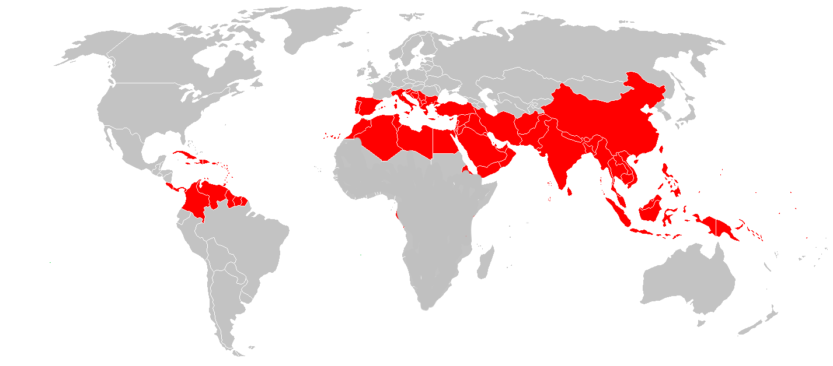

What is thalassaemia?
Thalassaemia is the name for a group of inherited conditions that affect the production of haemoglobin.
15

Slide 16
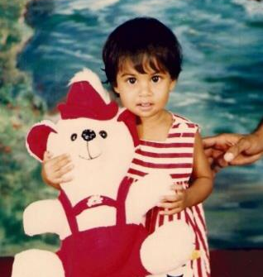

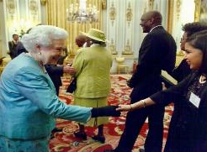


Life with thalassaemia

Slide 17
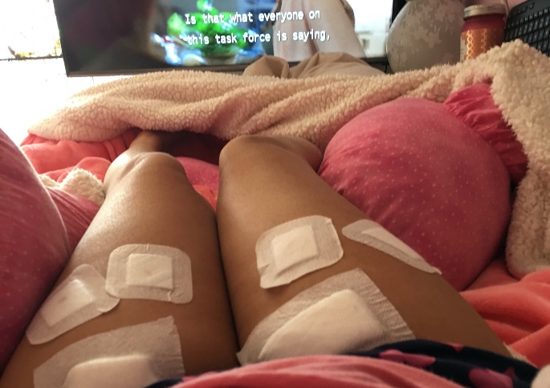
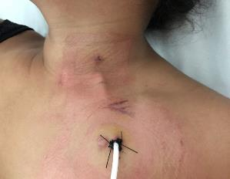
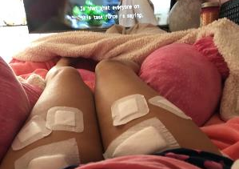
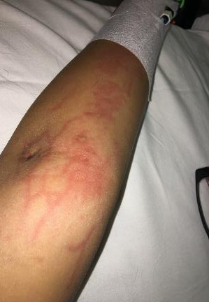
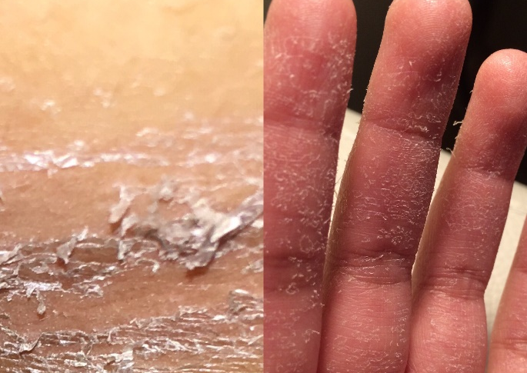
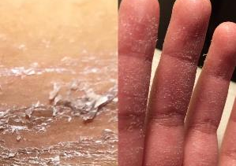

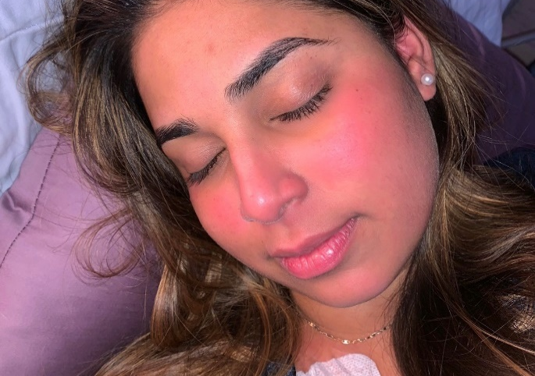

Not so invincible anymore

Slide 18
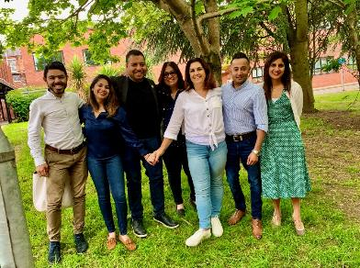
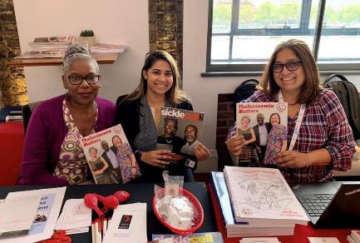
My role within UKTS AND NHSSCTSP

Slide 19
Menti Questions

Slide 20
Project delivery:
Sickle cell and thalassaemia (SCT) counselling knowledge and skills
Jamili Miah – Project and Implementation Lead NBS Screening Programme
Empowering to deliver together

Slide 21















Organisations

Slide 22

Old SCT Counselling Competences
A4 folder
Over 100 pages
Too much text / repetitive
Misleading title
Nowhere to capture evidence of accomplishment
Not easily accessible online
Not well implemented

Slide 23
User needs
a shorter, concise set of competences that can be achieved within very busy workloads
an assessment record that shows trainee practitioners are working towards achieving the competences
signposting to education and training resources for trainee practitioners, especially those working in low prevalence areas where access to an expert clinical network is not as easy

Slide 24
Timeline
Sep 2018
First working group meeting
Chair - Dr Lola Oni
March 2019
Final working group meeting
Piloted
Sept 2019
Published
Blog
Needed to be more user friendly
Finalised

Slide 25
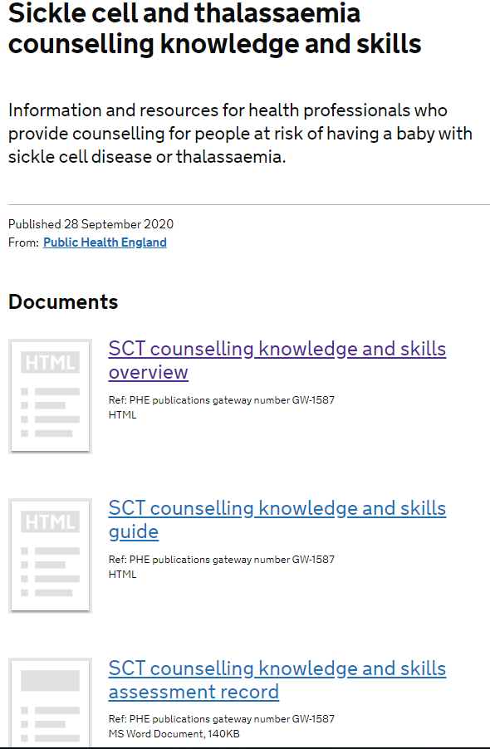
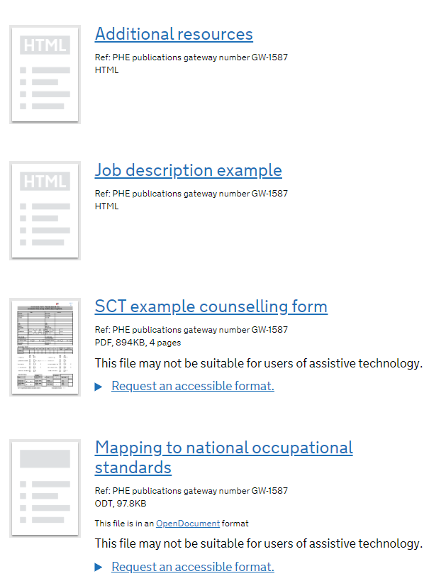

Slide 26
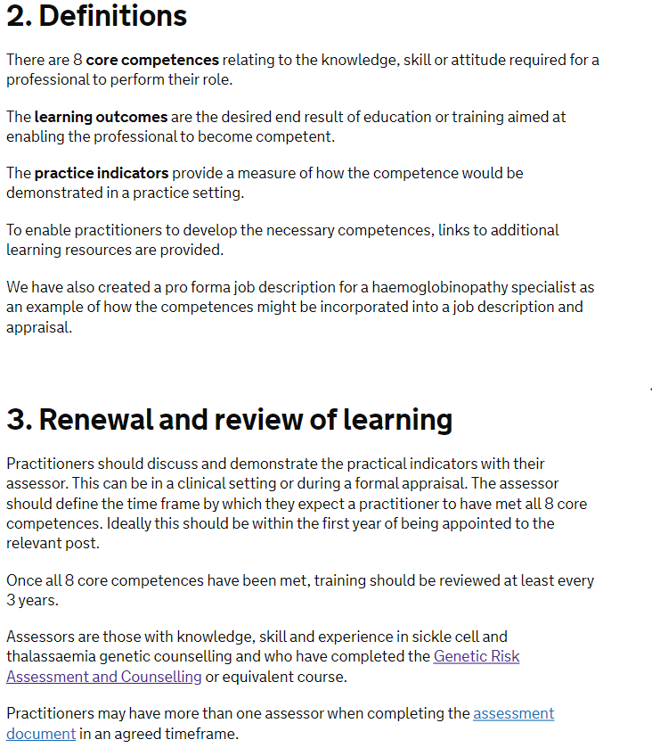
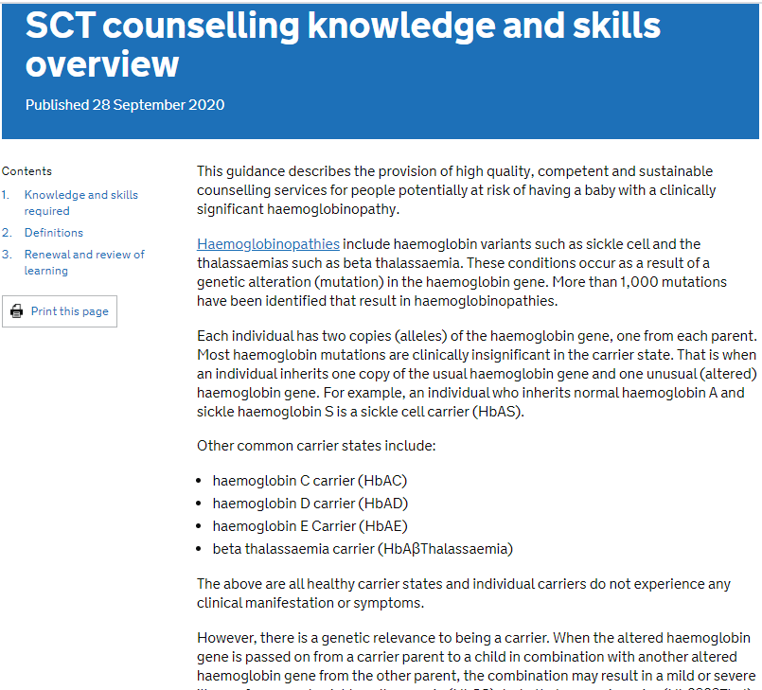

Slide 27
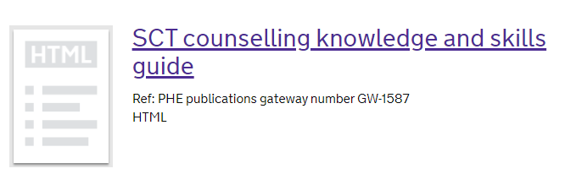
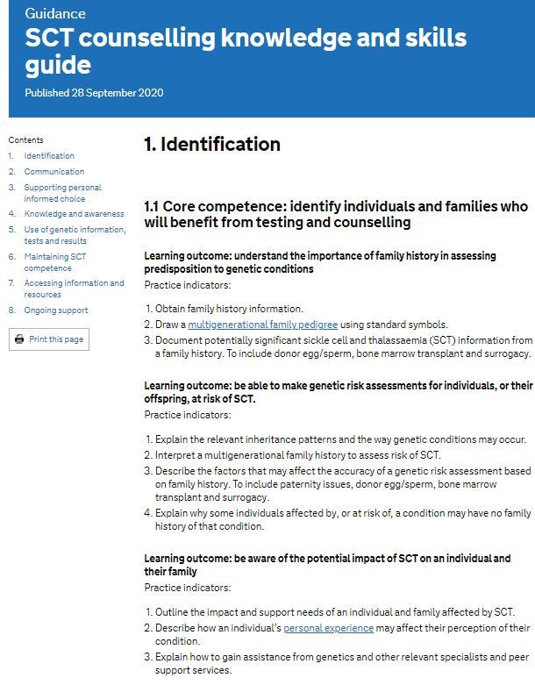
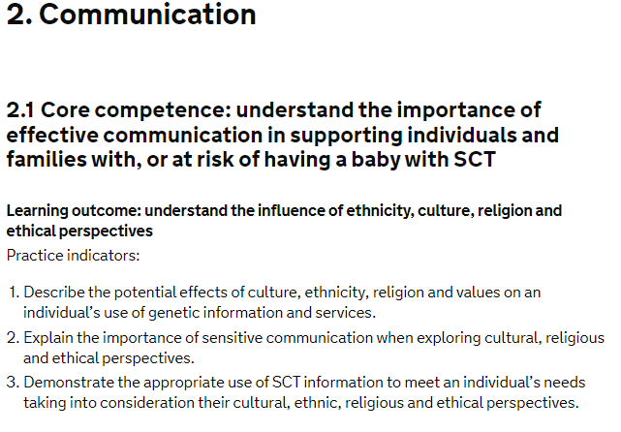

Slide 28
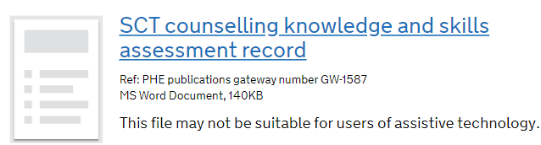
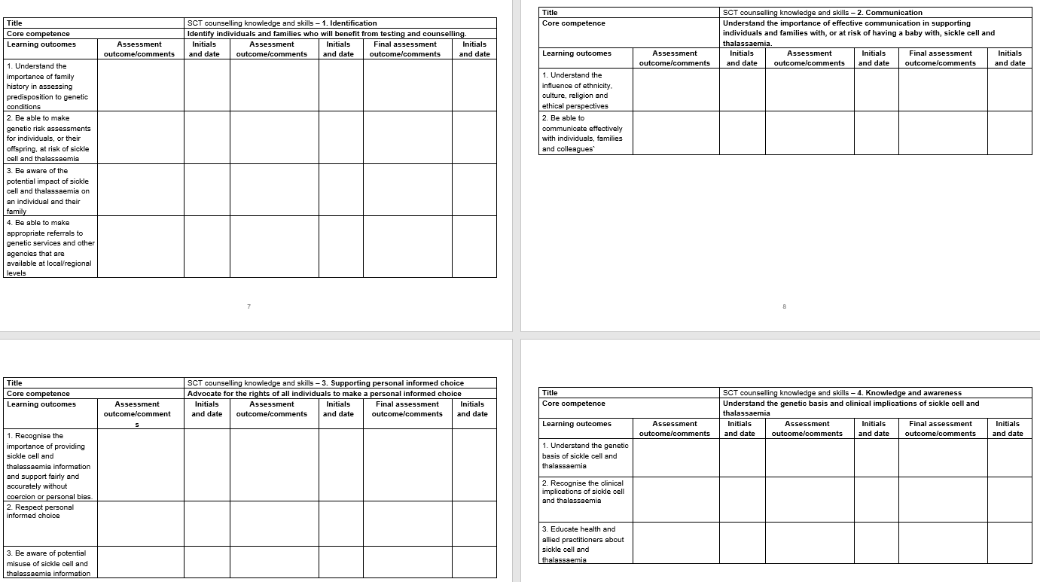

Slide 29
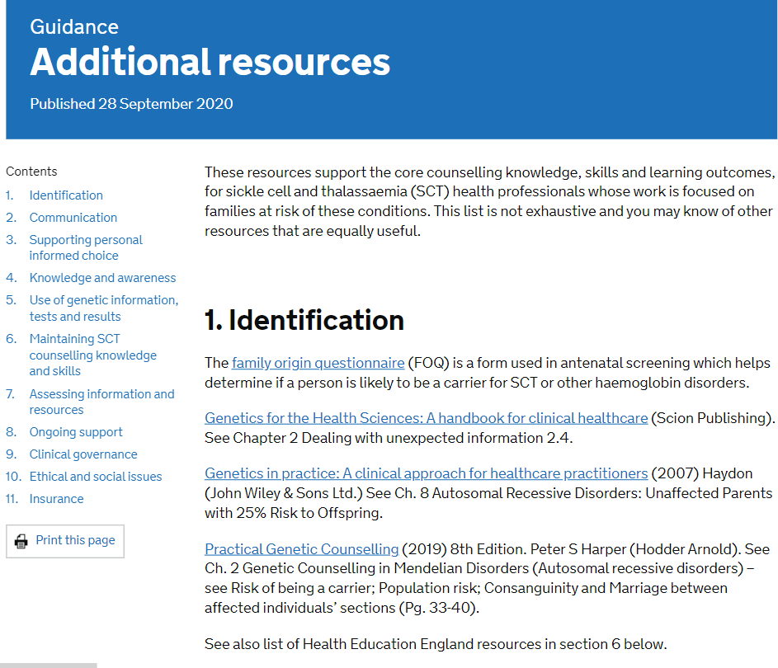
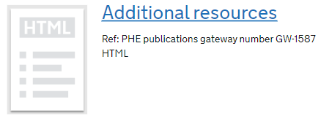
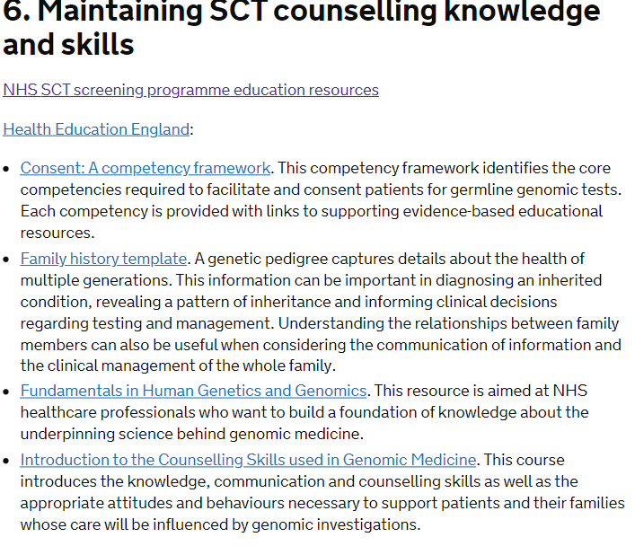
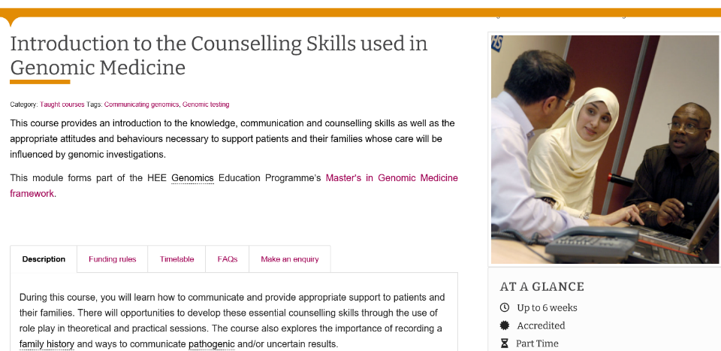
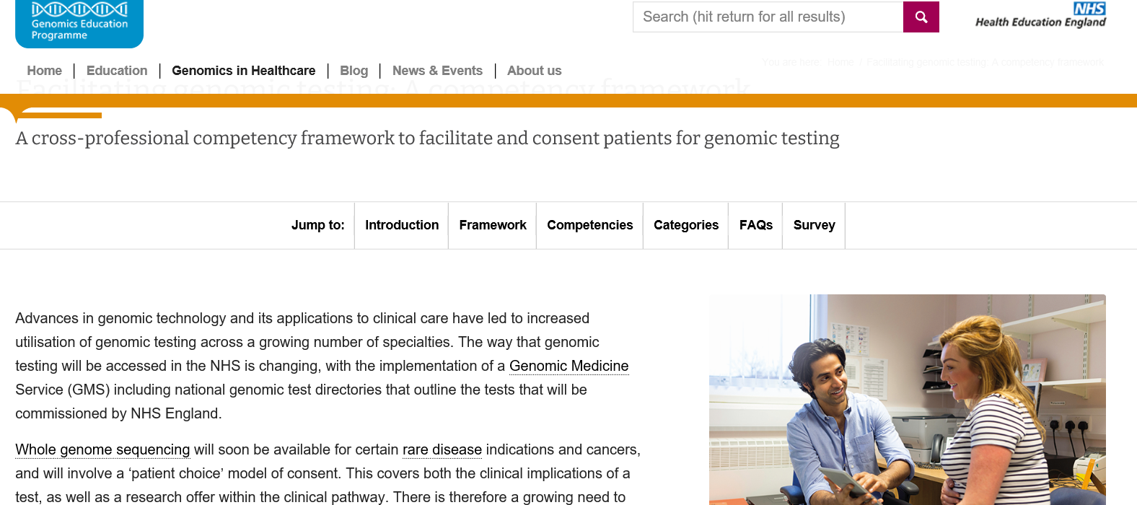
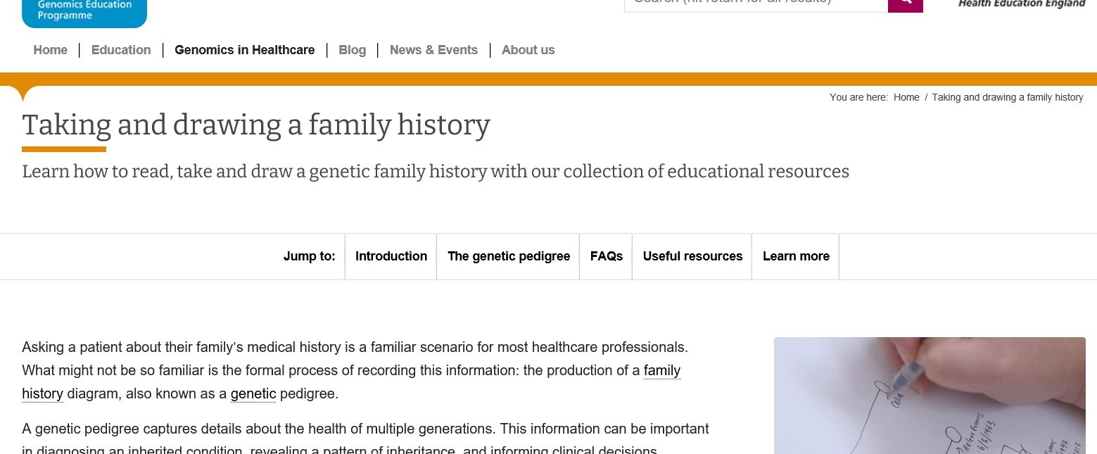


Slide 30
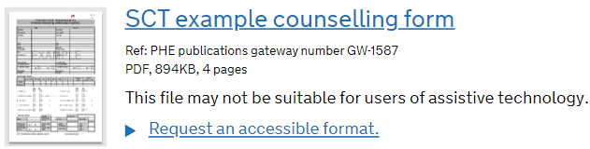
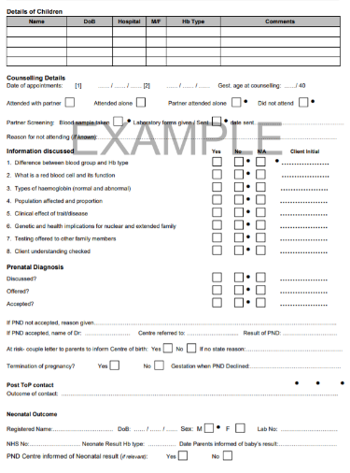
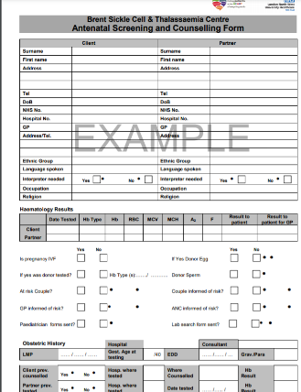

Slide 31
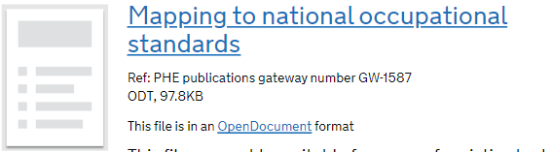
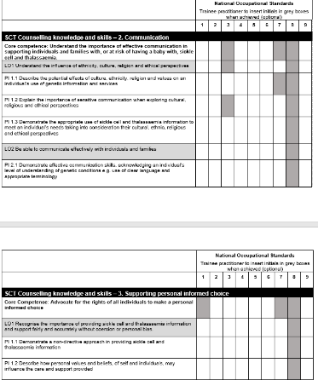
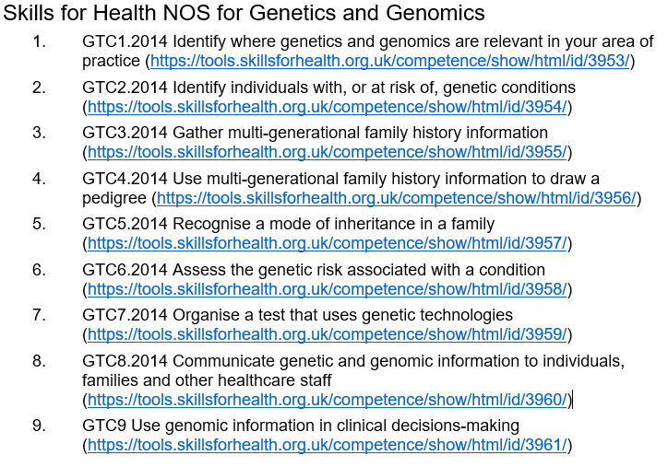

Slide 32
Feedback
Resources are reviewed every 3 years
Email your feedback/suggestions to PHE.screeninghelpdesk@nhs.net

Slide 33
Thank you

Slide 34
Menti Questions
Jamili & Lola

Slide 35
Comfort Break
NHS Sickle Cell and Thalassaemia Screening Programme’s Live Webinar, 28th January 2021

Slide 36
NHS Sickle Cell & Thalassaemia Screening Programme
Publications go digital
Cynthia Gill – SCT Programme Advisor
Siobhan Ryan – SCT Project Lead

Slide 37
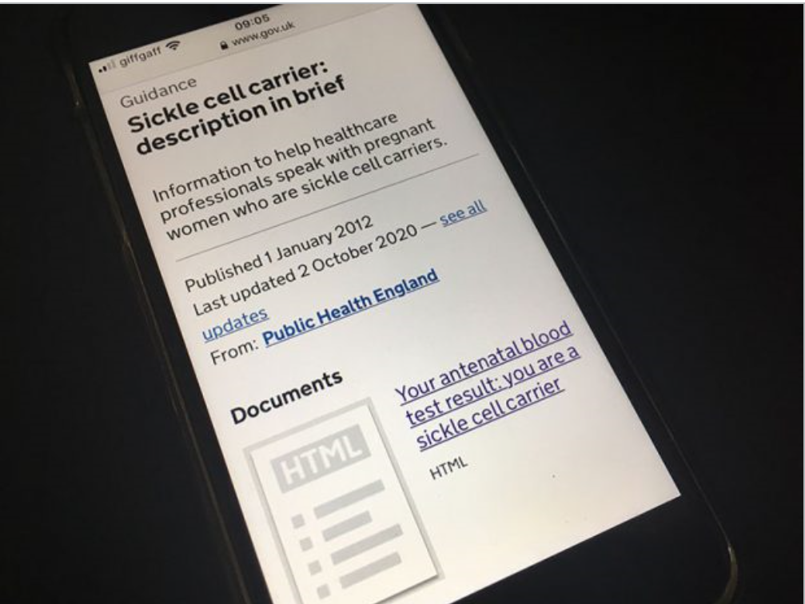
Digital by default
All the programme resources are now digital
Transition to digital is supported by user research which show that most women benefit from, and expect digital information
We are supporting services in England to move to using digital versions of the antenatal and newborn (ANNB) screening and carrier leaflets
Digital versions of the leaflets:
      Are easy to edit, so they always contain the most up to date information
      Are in a format that can be used with assistive technologies
      Work well on smaller screens such as phones
      Can be saved to a smart phone home screens like an app
Notes:
Make sure the information is correct

Slide 38
Accessible Information
Leaflets are required to meet Government accessibility
standards
The new format we are using:
Makes the leaflets easy to find with search engines
Can be accessed on a variety of devices
Can be printed out by HCPs to be given to those who are not online
The language:
Remains in “Plain English” – allowing the information to be easily understood
Jargon and abbreviations are avoided
Technical terms are fully explained
Notes:
Our leaflets as with all documents published on GOV.UK must meet accessibility standards so they can be used by as many people as possible, including those with disabilities.
If our documents do not meet the standards PHE could be breaking the law.
Making a website or mobile app accessible means making sure it can be used by as many people as possible including those with impaired vision, motor difficulties, cognitive impairments or learning disabilities and deafness or impaired hearing.
For example: the content has to be accessible to assistive technologies like screen readers.
HTML is the default used across PHE and government.

Slide 39








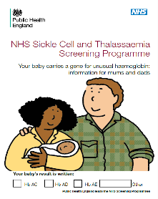
The plan
Printed screening and carrier leaflets are being phased out, with a move to information which is digital by default
We have created a digital format for
8 antenatal leaflets for adult carriers
2 antenatal leaflets for women and couples at risk of having a baby with a haemoglobinopathy
2 newborn leaflets for parents of babies who carry a gene for unusual haemoglobin
And we blogged to inform professionals in October 2020
https://phescreening.blog.gov.uk/2020/10/14/sickle-cell-and-thalassaemia-carrier-leaflets-go-digital/
Notes:
Newborn leaflets were also available translated into French, Bengali and Urdu.

Slide 40
The process
Advises on content of the leaflet and user needs
Clinical
advisor
IEPP
Programme team
Create standard leaflet format and advise on programme requirements
Check for language & accessibility and publish to GOV.UK website
Notes:
Programme team includes Programme Manager, a project lead and project support from the PPMO team
IEPP = information and education for public and professionals

Slide 41
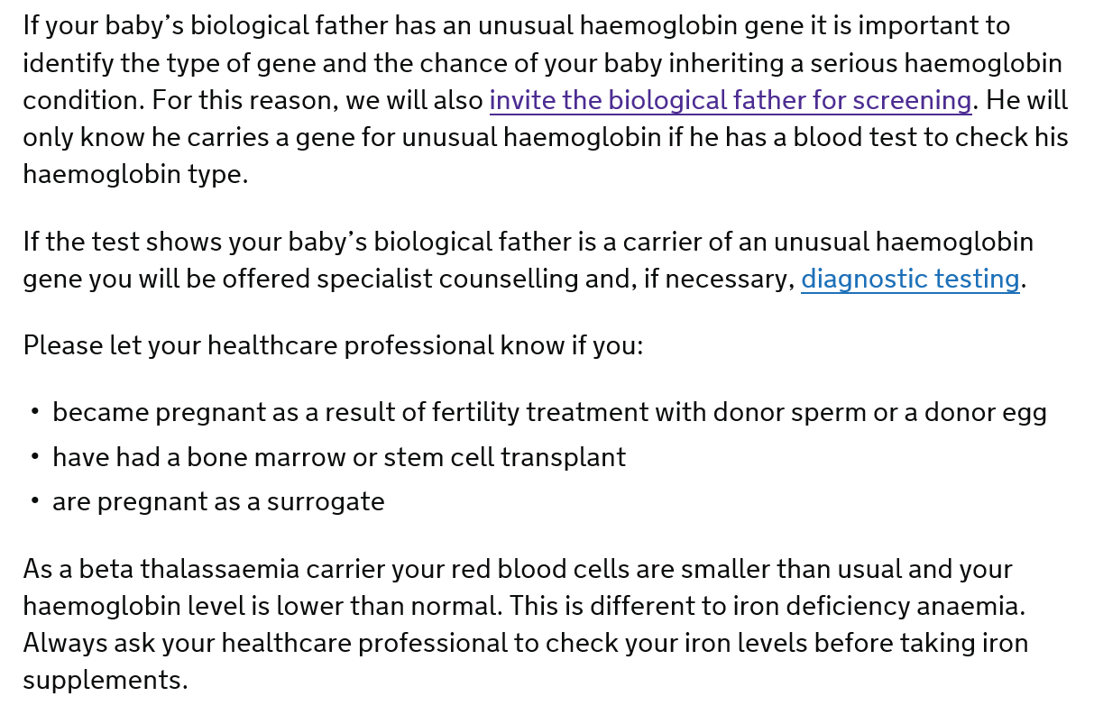
Aim of antenatal carrier leaflets
To inform the pregnant woman of what her carrier status means to her and her baby
Has information specific to her carrier status
To invite baby’s biological father for screening
Clear unambiguous language
Links to other PHE publications
Notes:
Use of term baby’s biological father
Responsive to increasing numbers of assisted pregnancies

Slide 42
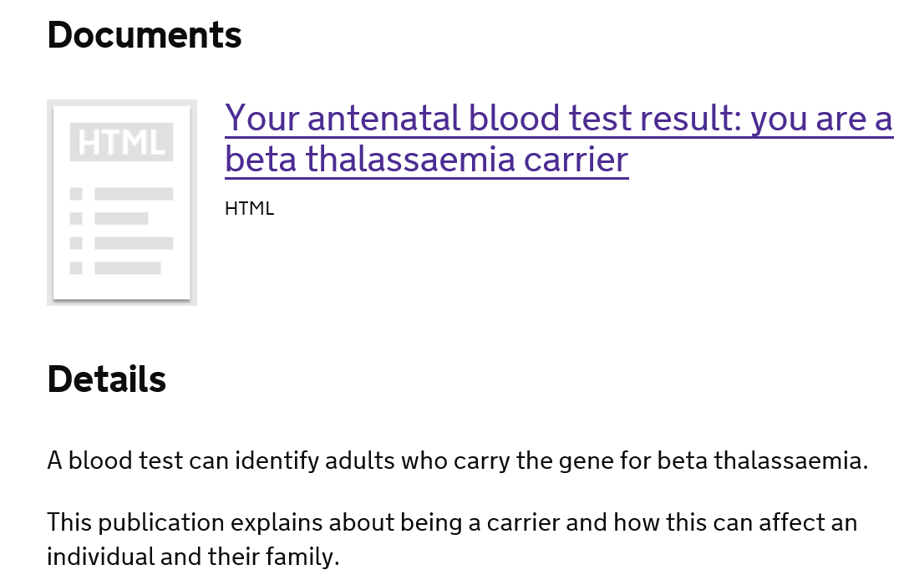
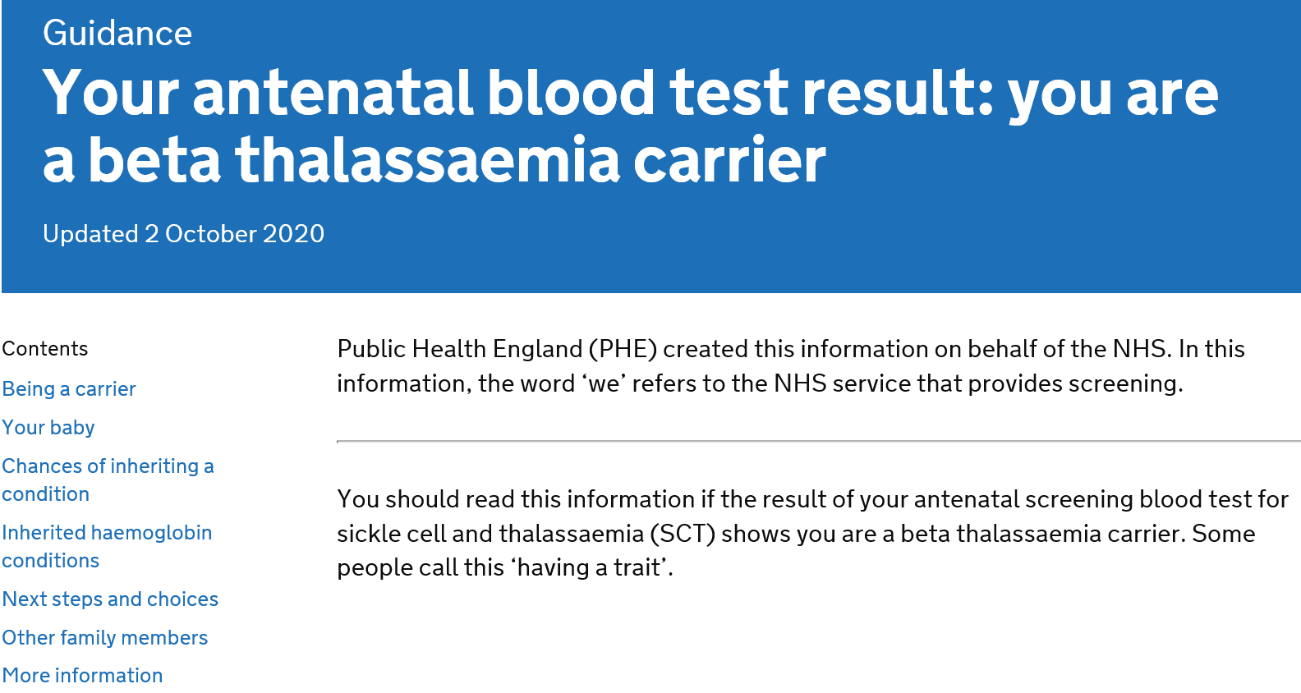
The result (1)
Clear headings
Standard layout
Links in the text make navigation quick and easy
Notes:
Clicking on the document title takes you to the document.
Clicking on the titles in the contents take you to that section

Slide 43
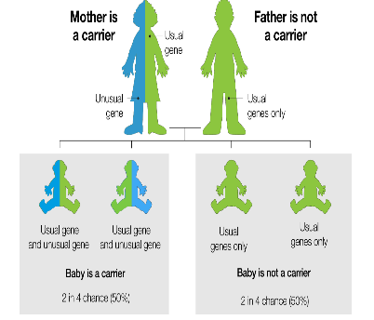
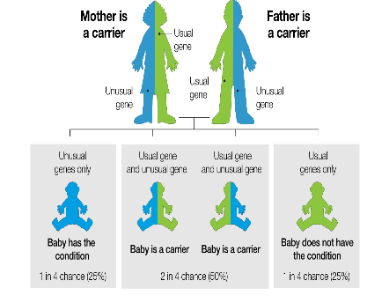
The result (2)
Graphics for healthcare professionals to use to explain inheritance to women or couples and discuss next steps and choices

Slide 44
To consider
Information is targeted to antenatal woman who is a carrier. What about information for carrier fathers?
Accessible carrier information for individuals who do not read well?
Accessible carrier information for individuals whose first language is not English?

Slide 45
Laboratory Handbooks
Dr Yvonne Daniel

Slide 46
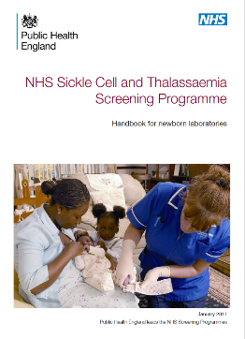
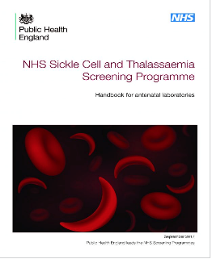
Handbooks
Update cycle – 2 years
  Current versions published 2017
Antenatal handbook
  Approved
  Waiting for final review
Newborn handbook
  Pending final edits and approvals
Programme handbook
  Pending final edits and approvals
Published as HTML
46 – Laboratory Handbooks

Slide 47
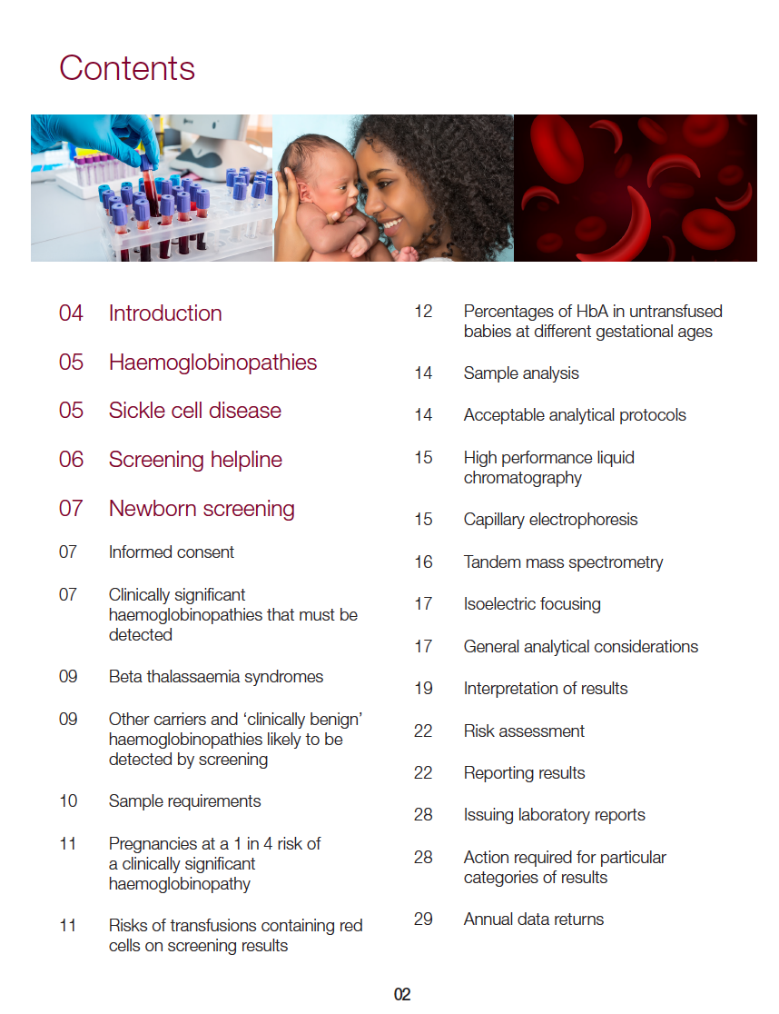
Handbooks
Detailed guidance for the laboratories:
  Methods
  Instruments
  Protocols
  Testing strategies
  Interpretation,
  Reporting
  Risk assessments
47 - Laboratory Handbooks

Slide 48

Review criteria
Incidents
Queries
  Programme Helpline
  Support Service
Changes in practice
New guidance
Feedback from work shops/training events
Advisory groups
  UK NEQAS
48 - Laboratory Handbooks

Slide 49


What’s new: Newborn
2020
2021
MSMS – guidance updated
  More users more cases more evidence
  Limitations of techniques
  More explicit in appropriate second test techniques
Linkage with UKAS

Slide 50


What’s new: Antenatal
2020
2021
Language more consistent across handbooks
Removed some schematics due to increasing complexity
Emphasised co-inheritance of conditions
Linkage with UKAS

Slide 51

NHSE –
Genomics Laboratory Hubs
7 Genomics Centres
4 Haematology
Implementation on going
Ultimately no direct charge to requestor
PHE engagement:
  Reporting
  Testing strategies for DNA transfused babies
  Ensure that it meets the needs of the screening programme

Slide 52

Thank you

Slide 53
Menti Questions
Siobhan, Cynthia and Yvonne

Slide 54
Two New Publications and the Consultation with Sickle Cell Service Users
Iyamide Thomas, NHS Engagement Lead, Sickle Cell Society

Slide 55
Background & Objectives
In 2018 NHS SCT Programme Commissioned Sickle Cell Society and UKTS to work collaboratively with them in ‘Engagement, Outreach and Programme Development’ Project. Work Specification included:
Review and update publication ‘Sickle cell disease in childhood: standards and guidelines for clinical care’ (2010 Edition) –’Paediatric Standards’
Project Advisory Group decided that this publication should remain focused on the clinical management of sickle cell so added:
Update of ‘Parent’s Guide to Managing Sickle Cell Disease’ to include the wider determinants of health relevant to living with sickle cell (2012 Edition) – ‘Parents Handbook’

Slide 56
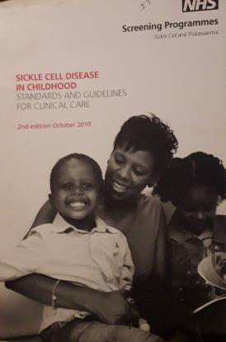
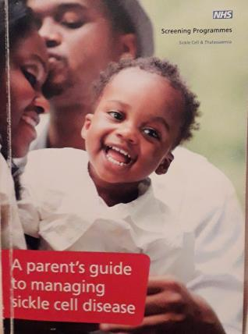
Updating Two New Publications
‘Paediatric Standards’
‘Parents Handbook’

Slide 57
Consultation Outputs
Consult stakeholders (i.e. sickle cell service users) to solicit opinion on any changes they might want to see and whether the Parents Handbook (PH) should be reproduced in print or electronic format.
Design and pilot user questionnaire at support group (PH only)
Finalise questionnaires for hard copy and online consultation
Disseminate hard copy to parents in Brent and Milton Keynes SCaT for on site completion (PH only)
Conduct service user focus group in central London
Design & Disseminate advertising graphics for online questionnaires
Analyse questionnaires and produce report for Editorial Teams of both publications to incorporate user feedback as necessary

Slide 58
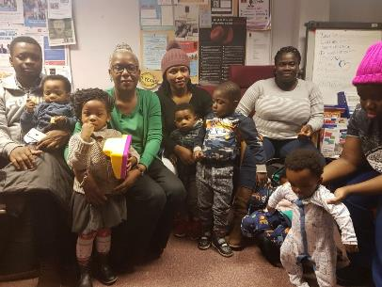
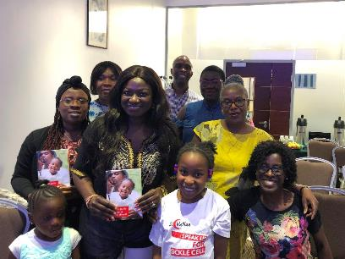
Consulting Parents Face-to-Face
Parents’ Support Group
Parents Focus Group in Euston

Slide 59

Galvanising Online User Input

Slide 60

Galvanising Online User Input

Slide 61
Some Summary Results for Parents Handbook
51 completed questionnaires returned – half done online
20% respondents knew nothing about SCD before the PH
97% stated they found the 2012 edition useful for reasons such as:
“Gives different signs and symptoms of the disease and what to look out for”
Parents who did not find the book useful said:
“Sometimes have difficulty reading the English or medical jargon”
90% felt a printed copy of the PH should be given to all new parents
67% said child’s symptoms less manageable without book
What format of the PH will you find most useful?
65% (Both internet and hard copy) 33% (Hard copy) 2% (internet copy)
What new information would you like in the Handbook?
“Parents’ Experiences”, “Breaking news of SCD to child”, “Direct references to legal /statutory support for parents to access when making bids to employers for flexible working” “ Extra curricular activities like ballet” “More information on potential need for counselling psychological support, particularly in adolescence and onwards”

Slide 62
Parents’ Handbook – What was Said
“I personally have learnt so much from this book. It has been like our second doctor in my house”
“The book is like the sickle cell bible, very useful”

Slide 63
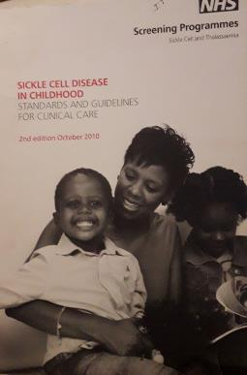
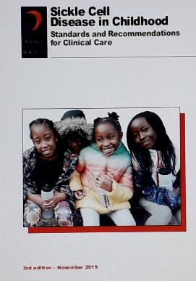
Paediatric Standards – Updated!
Second Edition - 2010
Third Edition - 2019

Slide 64


Parents Handbook – Updated!
Third Edition - 2012
Fourth Edition - 2021

Slide 65
Sickle Cell Disease in Childhood: Standards and Recommendations for Clinical Care.
Dr Moira Dick and Professor David Rees on behalf of PHE and the Sickle Cell Society

Slide 66

httpstandards/
https://www.sicklecellsociety.org/paediatricstandards/
Dr Moira Dick and Professor David Rees on behalf of PHE and the Sickle Cell Society

Slide 67
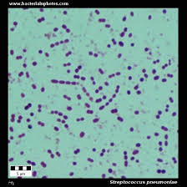
Sickle cell disease as it was then
a rare childhood disease in 1970s- 90s
considered an acute hospital issue
childhood mortality 10% due to infection, stroke, acute splenic sequestration, worsening anaemia, acute chest syndrome
approximately 2000 adults and children in the UK with main populations in London and Birmingham (survey 1979) Davis LR et al BMJ 1981 282
antenatal and newborn screening was inconsistent across country
Infants not always followed up after screening Assessment of care of children with sickle cell disease: implications for neonatal screening programmes. R I Milne BMJ 1990 300

Slide 68
Implications due to lack of newborn screening and quality of follow up
infant deaths from pneumococcal sepsis or acute splenic sequestration occurred before diagnosis made
understanding of cerebral vasculopathy limited as no MRI/TCD
most paediatricians had little or no training or experience in sickle cell disease
was it a paediatric or a haematological condition?
resources and services varied enormously across the country
widespread experience of stigma
racist attitudes prevalent
MRI magnetic resonance imaging
TCD transcranial Doppler scanning

Slide 69

First edition paediatric standards 2005
developed in 2005 on behalf of BSH to support roll out of universal newborn screening and aimed at those clinicians working in areas of low prevalence
dealt with organisation of care as much as clinical recommendations
audit standards were included – timeliness into care and prescription of penicillin, timeliness of Pneumovax, follow up and failsafe arrangements, coverage of TCDs
evidence only in four areas- penicillin prophylaxis, TCD screening , hydroxyurea and incentive spirometry
mainly based on good practice from UK and USA
BSH : British Society of Haematology

Slide 70

2nd edition 2010
Sickle cell disease in childhood Standards and Guidelines for clinical care
added a standard on data collection and National Haemoglobin Registry (NHR)
included clinical peer review quality requirements and specialist services definitions

Slide 71
Latest edition 2019
Standards and clinical recommendations for care of children with SCD
recommendations on cerebrovascular disease, preoperative transfusion and hydroxycarbamide therapy updated as evidence now available in these areas
standards strengthened in line with Public Health England guidance and Metric Definition Sets that inform the Specialised Services Quality Dashboard commissioned by NHS England
new standards on coverage of children prescribed hydroxyurea, coverage of children on NHR and completion of annual review
a new information technology system linked with NHR for referring infants from newborn screening into treatment introduced. https://www.gov.uk/government/publications/sickle-cell-and-thalassaemia-screening-newborn-outcomes-system/clinical-user-guide-newborn-outcomes-system

Slide 72
Grade A recommendations
Requires at least one clinical trial
the TWiTCH study looked at the safety of switching children with abnormal TCDs from regular transfusions to hydroxycarbamide and found that hydroxycarbamide was equivalent to transfusion, with no increase in TCD velocities or cerebrovascular events (A)
children with HbSS and HbS/β⁰ thalassaemia undergoing low- and moderate-risk surgery should have a preoperative transfusion to increase the Hb level to 100 g/L (A)
DeBaun MR, Gordon M, McKinstry RC, et al. Controlled trial of transfusions for silent cerebral infarcts in sickle cell anemia. N Engl J Med 2014 Aug 21;371: 669–710
WareRE, DavisBR, SchultzWH, et al. Hydroxycarbamide versus chronic transfusion for maintenance of transcranial doppler flow velocities in children with sickle cell anaemia—TCD With Transfusions Changing to Hydroxyurea (TWiTCH): a multicentre, open-label, phase 3, non-inferiority trial. Lancet 2016; 387: 661–70.
Howard J, Malfroy M, Llewelyn C et al. The Transfusion Alternatives Preoperatively in Sickle Cell Disease (TAPS) study: a randomised, controlled, multicentre clinical trial. Lancet 2013; 381: 930–8.

Slide 73
Hydroxycarbamide ( hydroxyurea)
hydroxycarbamide should be offered to all children with HbSS/Sβ⁰ thalassaemia aged 9–42 months regardless of the clinical severity of their illness. (A) See Standard 6.
hydroxycarbamide should be offered to all children older than 42 months who have recurrent episodes of acute pain or who have had two or more episodes of acute sickle chest syndrome (A)
hydroxycarbamide should be offered to all children older than 42 months whose lives are significantly affected by symptoms of SCD, including those with frequent episodes of pain that disrupt normal activities (A)
hydroxycarbamide should be offered to all children older than 42 months who are at high risk of progressive organ damage caused by SCD, including those with hypoxemia, significant albuminuria, conditional TCD velocities, or significant anaemia (steady state Hb<70 g/L) (B)
Qureshi A, Kaya B, Pancham S, et al. Guidelines for the use of hydroxycarbamide in children and adults with sickle cell disease: A British Society for Haematology Guideline. Br J Haematol 2018;181:460–75.

Slide 74
Standards- alignment and data collection
Standard 1 (SCT-S08): Sickle cell and thalassaemia screening – reporting newborn screen-positive results to parents Newborn clinical outcome system (NBO)
Standard 2 (SCT-09 HAEM 4A): Sickle cell and thalassaemia screening – timely follow up, diagnosis and treatment of newborn infants with a positive screening result NBO
Standard 3: (HAEM 4B) Timeliness of penicillin prophylaxis NBO
Standard 4: Coverage of pneumococcal immunisation at 2 years ? NHR
Standard 5 (HAEM02) Coverage of transcranial Doppler (TCD) scanning ? NHR
Standard 6: Coverage of hydroxycarbamide (hydroxyurea) therapy ? NHR
Standard 7: Coverage of children identified through the screening programmed subsequently registered on the national haemoglobinopathy registry NBO/NHR
Standard 8: ( HAEM08) Coverage of children who have had an annual review NHR
https://www.gov.uk/government/publications/sickle-cell-and-thalassaemia-screening-newborn-outcomes-system/clinical-user-guide-newborn-outcomes-system

Slide 75
Acknowledgements – and thanks to everyone who took part in the consultation
Writing group members:
Dr Kofi Anie,MBE Consultant Clinical Psychologist, Brent Sickle Cell and Thalassaemia Centre, London
Dr Subarna Chakravorty, Consultant Paediatric Haematologist, King’s College Hospital, London and member of the peer review team
Susan Raybould, Specialist Nurse Haemoglobinopathy, Birmingham Sickle Cell and Thalassaemia Service
Cathy Coppinger, NHS Sickle Cell & Thalassaemia Screening Programme, Public Health England
Giselle Padmore-Payne, Senior Clinical Nurse Specialist Haemoglobinopathy Transition, King’s College Hospital, London
Iyamide Thomas, Sickle cell Society
Dr Jacky Wilson, Medical Editor
and additional specialist input from:
Dr Karl Atkin, Department of Health Sciences, University of York
Dr Mark Velangi, Consultant Paediatric Haematologist, Birmingham Children’s Hospital and member of the peer review team
Dr Jo Howard, Consultant Haematologist, Guy’s Hospital, London and chair of the UK Forum on Haemoglobin Disorders ( until 2019)
Dr Kate Ryan, Consultant Haematologist, Manchester Royal Infirmary and chair of the Clinical Reference Group for Haemoglobinopathy Specialist Commissioning.(until 2019)

Slide 76
Menti Questions
Iyamide & Moira

Slide 77
Thank you and closing remarks
Chair: Professor Dame Elizabeth N Anionwu DBE CBE FRCN FQNI PHD
Emeritus Professor of Nursing, University of West London

